Slide 1
Starting and Staying Healthy- Baltimore Healthy Start’s Safer Childbirth Cities Initiative

Slide 2
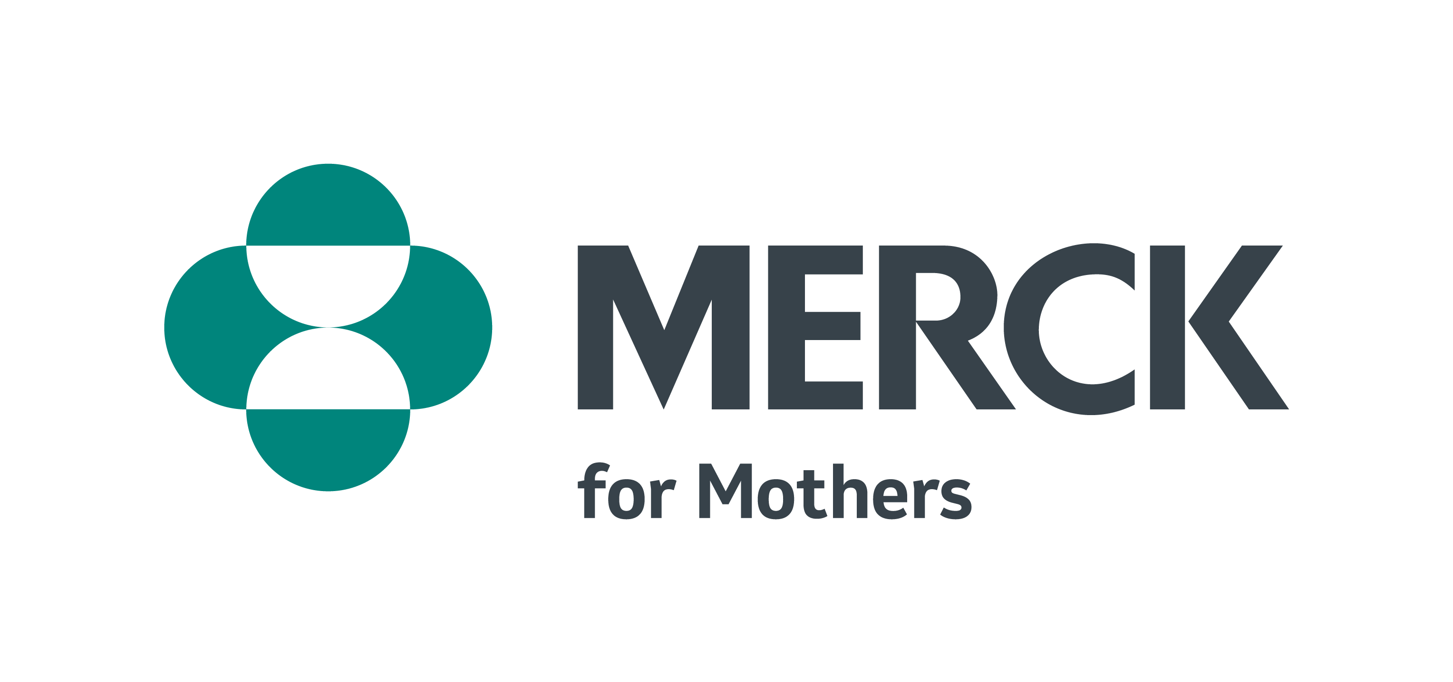
Introduction & Background SCCI
The Merck for Mothers Safer Childbirth Cities Initiative aims to support community-based leaders in U.S. cities with a high burden of maternal mortality and morbidity to implement evidence-based interventions and innovative approaches to reverse the country’s maternal health trends.
Lashelle Stewart, MBA
Executive Director
Baltimore Healthy Start, Inc.

Slide 3
Baltimore Healthy Start- Who We Are
Established in 1991 as a 501(c)3 nonprofit corporation
One of the original 15 Healthy Start projects
Community Based Grassroots Organization
Direct Staff are Community Health Workers
Member of Maryland Nonprofits
B’More for Healthy Babies Partner

Slide 4
Mission- Baltimore Healthy Start
Baltimore Healthy Start, Inc. is committed to reducing infant and maternal mortality and morbidity by utilizing a Life Course Perspective for improving the health and well-being of women and their families through the provision of comprehensive, supportive services offered in the communities where they live.

Slide 5
Baltimore Safer Childbirth Cities Initiative
Baltimore Healthy Start (BHS) received the Merck for Mothers Safer Childbirth Cities grant in September 2019. The BHS project addresses and improves maternal health outcomes through five project aims, covering the areas of Citywide Surveillance, Quality Improvement, Direct Service, and Sustainability.

Slide 6
Baltimore Safer Childbirth Cities Initiative
Augment the State of Maryland’s maternal mortality review process with a Baltimore-focused severe maternal morbidity (SMM) review process.
Implement a “Patients as Partners” initiative to bring the knowledge and experience of maternity patients to bear on hospital and health system quality improvement processes.
Implement a Maternal Health Monitoring Intervention (MHMI) of prenatal and postpartum home-based assessments for BHS clients, with immediate medical referral if indicated.
Provide postpartum care services, delivered by certified registered nurse practitioners, co-located and co-scheduled in FQHC pediatric clinics at 2-week, 4-week, 2-month, 4-month, 6-month, and 12-month infant well-child visits.
Seek funding to develop and support other evidence-based maternal health direct services, and patient-centered maternal health research initiatives.

Slide 7
Partners

Slide 8
Partners
It’s also worth mentioning that BHS sits on several committees that create opportunities for not only recommendations, but collaborations and interactions that expand community outreach and engagement.
Fetal Infant Mortality Review Committee (FIMR)
Child Fatality Review Committee (CFR)
Maternal Mortality Review Committee (MMR)
Statewide Integrated Health Improvement Strategy (SIHIS)
Maternal Health Improvement Program (MHIP- MDMOM)
Implicit bias skill-building sessions and training for Maryland perinatal healthcare providers
EMPOWER Moms- urgent maternal warning signs training for home visiting programs statewide and education for pregnant and postpartum clients
Clergy & Community Roundtable

Slide 9
Purpose of Baltimore-focused SMM Review
To identify and understand the contributing factors of severe maternal morbidity, in order to prevent injuries that lead to mortality
Highlight opportunities and make recommendations for improvement in care, in order to prevent future incidents of severe morbidity and mortality.
The experience of Baltimore’s Fetal Infant Mortality Review (FIMR) demonstrates the value of patient accounts in identifying clinical and system issues for improvement.

Slide 10
SMM Identification and Review Criteria
Facility-based reviews per CDC SMM identification and review criteria
What events should be reviewed?
Pregnant, peripartum, or postpartum women receiving 4 or more units of blood products
Pregnant, peripartum, or postpartum women who are admitted to an ICU as defined by the birth facility
Other pregnant, peripartum, or postpartum women who have an unexpected and severe medical event – at the discretion of the birth facility

Slide 11
Baltimore City Maternal Mortality Review (MMR)
In 2021, the Baltimore City Health Department developed and launched a local MMR Committee that reviews cases of maternal mortality, in addition to incidences of severe maternal morbidity. This team collaborates with State and community partners to identify gaps in local systems, recommends strategies tailored to local needs, and works with community partners to implement those recommendations.
The Baltimore City MMR Team is comprised of health providers, prevention practitioners, and community leaders and advocates from across the City. Individuals were selected based on a combination of expertise, commitment, and the perspectives they represent. All selected individuals have been appointed by the Baltimore City Health Commissioner.

Slide 12
Purpose of Patients as Partners (PAP)
To understand the birth experiences of women in the city of Baltimore, in order to improve outcomes in maternal and newborn care.

Slide 13
Patients as Partners (PAP)
In partnership with The Preeclampsia Foundation, “Patients as Partners (PAP)” is an effort to learn from women who have recently had a baby, specifically about their experiences and interactions with the health care system, in order to improve the quality of maternity care in the city of Baltimore. The PAP project includes:
Focus groups to understand the experiences of women giving birth at Baltimore City hospitals
Patient advocacy training of focus group participants in telling their stories with a purpose
Maternity Care Forums where patients share their stories in real time with physicians and L&D nurses and staff, in an effort to work as partners to improve quality.

Slide 14
Dyad Care
Although not funded by the Merck grant, dyad care was an important maternal and child health objective in which BHS aimed to provide postpartum care services, delivered by Certified Registered Nurse Practitioners, co-located and co-scheduled in FQHC pediatric clinics, at 2-week, 4-week, 2-month, 6-month, and 12-month infant well-child visits to improve monitoring and timely response to maternal health complications in the postpartum period and utilization of postpartum care visits. Initially delayed by the COVID-19 pandemic, dyad care implementation has been underway since June 22, 2021, with a BHS CNA/NHA providing care and support in the OB clinic. To date, over 400 patients have been seen by a CRNP, and their data is entered in the EMR system. Clients continue to be scheduled, and are informed of the well baby/postpartum care that’s being offered. Posters, brochures, and other informational materials are available to patients onsite. (Developed and Implemented prior to the passing (April 2022 that all Medicaid Eligible clients have coverage for 12 months postpartum. Our visits are longer than typical visits so grant funding supplies funding needed.)
Due to the success of this care model, BHS is currently expanding this service to another clinic in Anne Arundel County (Glen Burnie, MD).

Slide 15
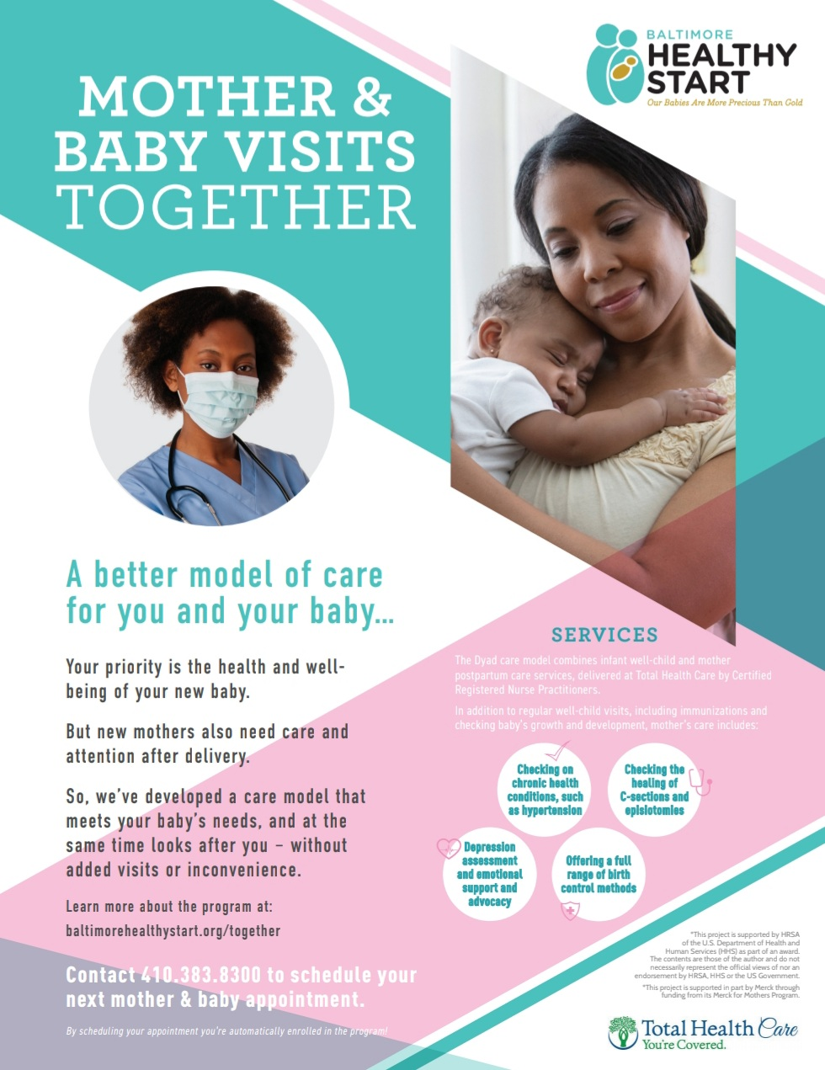
Dyad Care

Slide 16
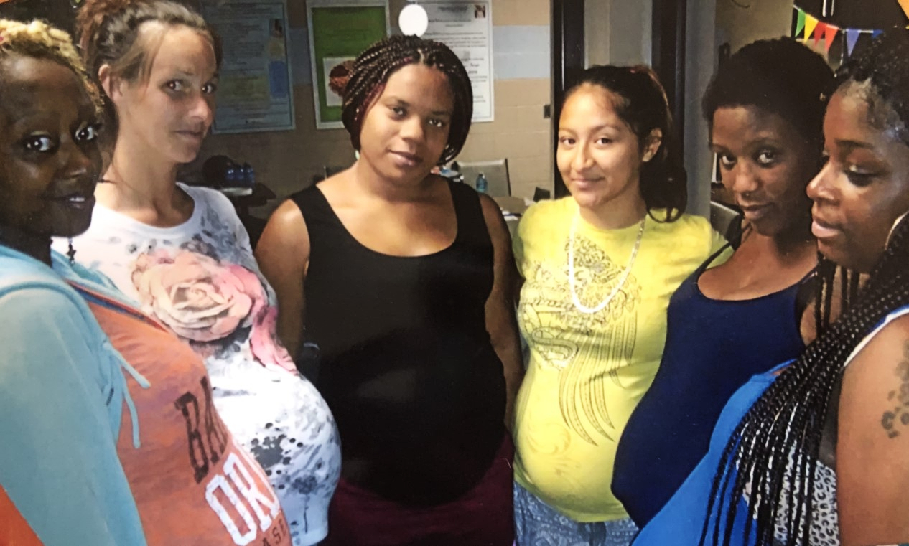
Maternal Health Monitoring Intervention (MHMI)
BHS implemented a Maternal Health Monitoring Intervention (MHMI) of prenatal and postpartum home-based assessments for BHS clients, with immediate medical referral if indicated. This checklist tool has been in use since November 1, 2019 by all home visitors on staff- Neighborhood Health Advocates (NHAs) and case managers, and continues to be a permanent part of the home visit assessment.
The MHMI helps to identify early warning signs and symptoms of prenatal and postpartum complications. Conditions such as deep vein thrombosis (DVT), preeclampsia, and hypertension have been able to be assessed, followed by appropriate action steps in order to reduce maternal morbidity and mortality and improve overall maternal health.

Slide 17
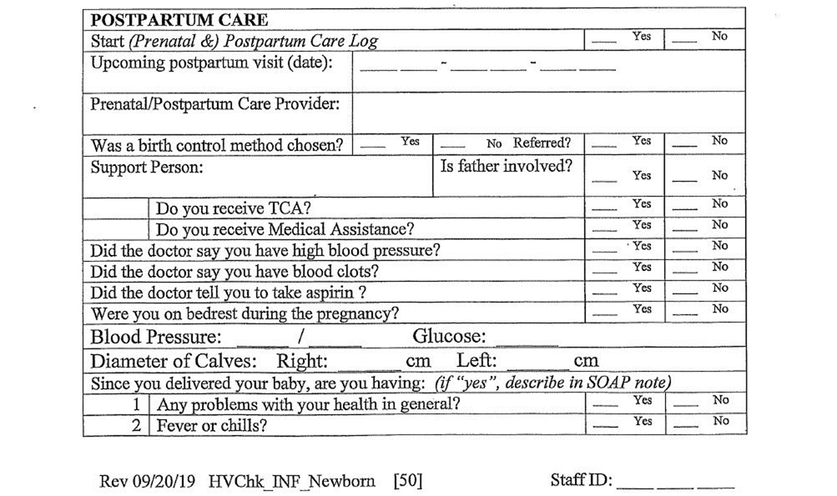

Slide 18
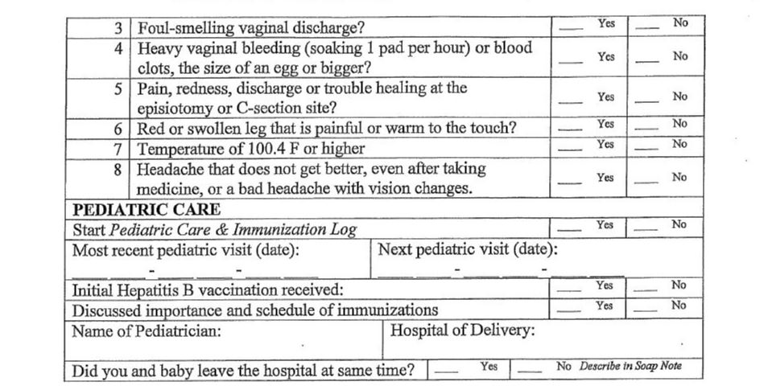

Slide 19
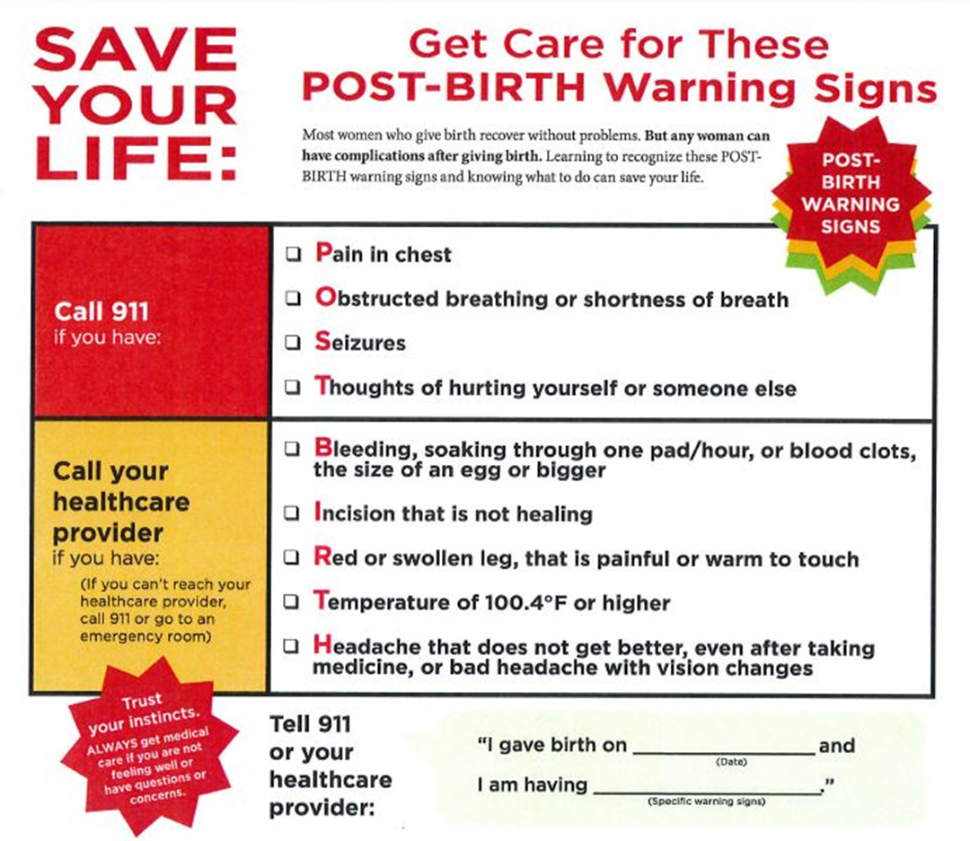

Slide 20
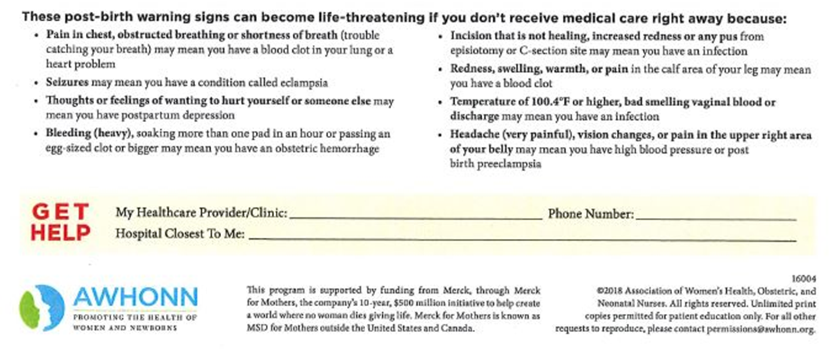

Slide 21
Baltimore Safer Childbirth Cities Community Action Network (CAN)
The BHS CAN meets bi-monthly and continues to be updated on the progress of Merck activities. Currently, the CAN has identified Maternal and Child Health as one of its priority areas, in addition to Housing Security.
The CAN involves Healthy Start participants, community-based organizations, health care providers, behavioral health providers, universities, insurance companies, and community leaders, in efforts to strengthen community service systems and address social determinants of health. BHS ensures that 25% of representation to the CAN is from BHS clients. The CAN serves as the vehicle for engaging community stakeholders in the process of involving the community in refining project design, as project planning and implementation continues to move forward.

Slide 22
Considerations
Baltimore Healthy Start services are grant funded not Medicaid reimbursed
Maryland does not offer reimbursement for Community Health Worker services
BHS knows that Community Health Workers are an integral part of the care team because health begins in the community
All BHS CHWs are Certified by the State of Maryland and the Executive Director is on the Maryland State Community Health Worker Advisory Committee

Slide 23
Questions?

Slide 24
Thank You!
Baltimore Safer Childbirth Cities Initiative Team:
Lashelle Stewart
Executive Director
lstewart@baltimorehealthystart.org
Maxine Reed-Vance
Deputy Director
Teneele M. Bruce
Maternal Health Coordinator
Peter Schafer
Consultant

