Slide 1

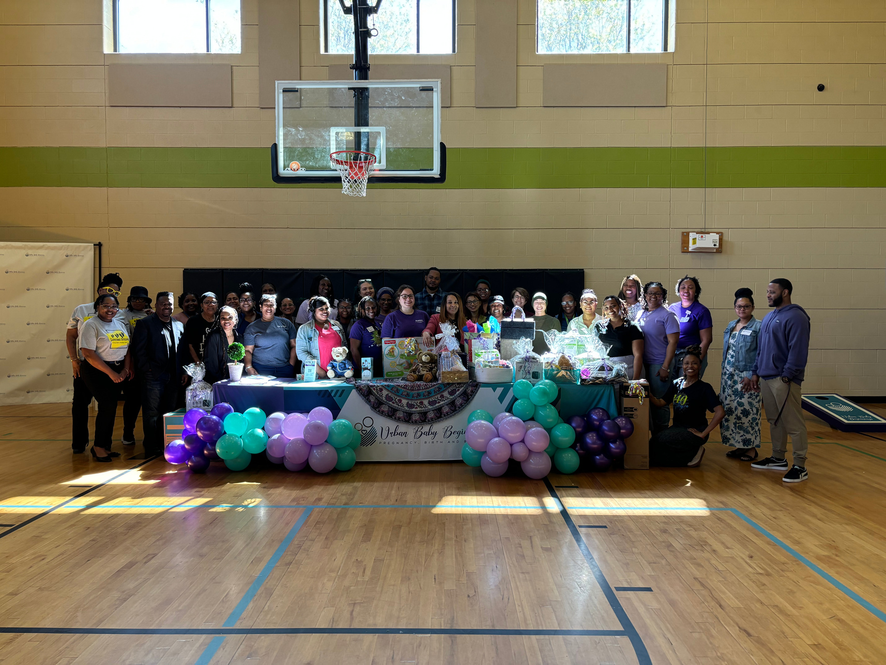



Building Safer Childbirth Cities
Presented by Stephanie Spencer 2024 Confidential and Proprietary
Content not to be used without expressed or written permission

Slide 2
07
Case Study: Urban Baby Beginnings
UBB Maternal Health Hubs are safe spaces that provide prenatal, postpartum and early childhood supports through the child’s 3rd birthday
($7.5 million HRSA State Innovation Grant)
ReByrth focuses on providing support to vulnerable families through the use of trusted community members and partners supported in UBB’s hub
($1 million Merck for Mothers Safer Childbirth Cities Grant)
The Maternal Quality Care alliance is a Collective Impact group focused on building a stronger care coordination network and enhancing safety at the ground level through the use of community-based safety bundles
(HRSA AIM CCI)
CARE COORDINATION, MATERNAL MENTAL HEALTH, LACTATION, NURSING SUPPORTS,DIAPER PILOT, COLLABORATIVE PARTNERSHIPS
FAMILY SUPPORT PROFESSIONALS SUCH AS COMMUNITY HEALTH WORKERS, HOME VISITORS, DOULAS, TELEHEALTH, WORKFORCE DEVELOPMENT
AIM CCI, HER STORY, HRSA MATERNAL HEALTH INNOVATION PARTNERS
Urban Baby Beginnings | All Rights Reserved 2024
2024 Confidential and Proprietary

Slide 3

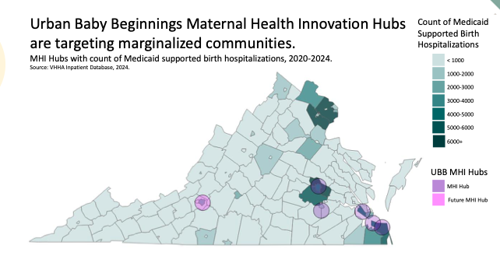
UBB Maternal Health Hubs
Urban Baby Beginnings | 2024 All Rights Reserved

Slide 4
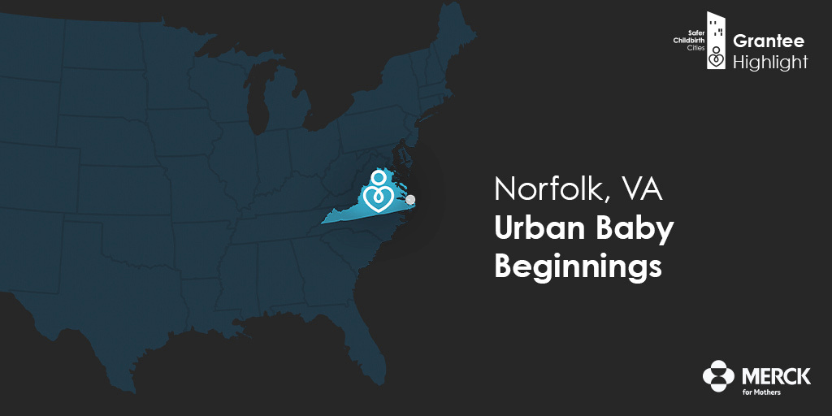


SAFER CHILDBIRTH CITIES
Presented by Stephanie Spencer 2024 Confidential and Proprietary

Slide 5
SAFER ZONES OF CARE REQUIRE
  Alignment
  Human-Centered Approach
  Understanding the why behind "community-informed and built systems"
  Uplifting community voices
  Respecting and honoring the influences of culture, values, and trust
  Addressing equity and bias internally
  Accountability
  Supporting the supporters
  Incorporating community health workers, doulas, perinatal providers, health navigators, and community-led organizations into the continuum of care
  Being social media savvy, providing virtual care, education, and resources
  Building networks of support and safety for both patients and providers
  Individualized safety protocols and care plans for women and their families
  Providing toolkits for perinatal workers
  True collaboration, partnership, and funding
  Collective Impact - sharing power and resources (non-hierarchial safe space)
Presented by Stephanie Spencer 2024 Confidential and Proprietary

Slide 6
2023 Reach
9,388
6,649
2,199
Calls
Care Coordination and
Education Visits
SDOH Referrals
1,293
432
28,415
432
In Home Visits
Doula Births
MCH CHW and
Doula Training Hours
Presented by Stephanie Spencer 2024 Confidential and Proprietary

Slide 7
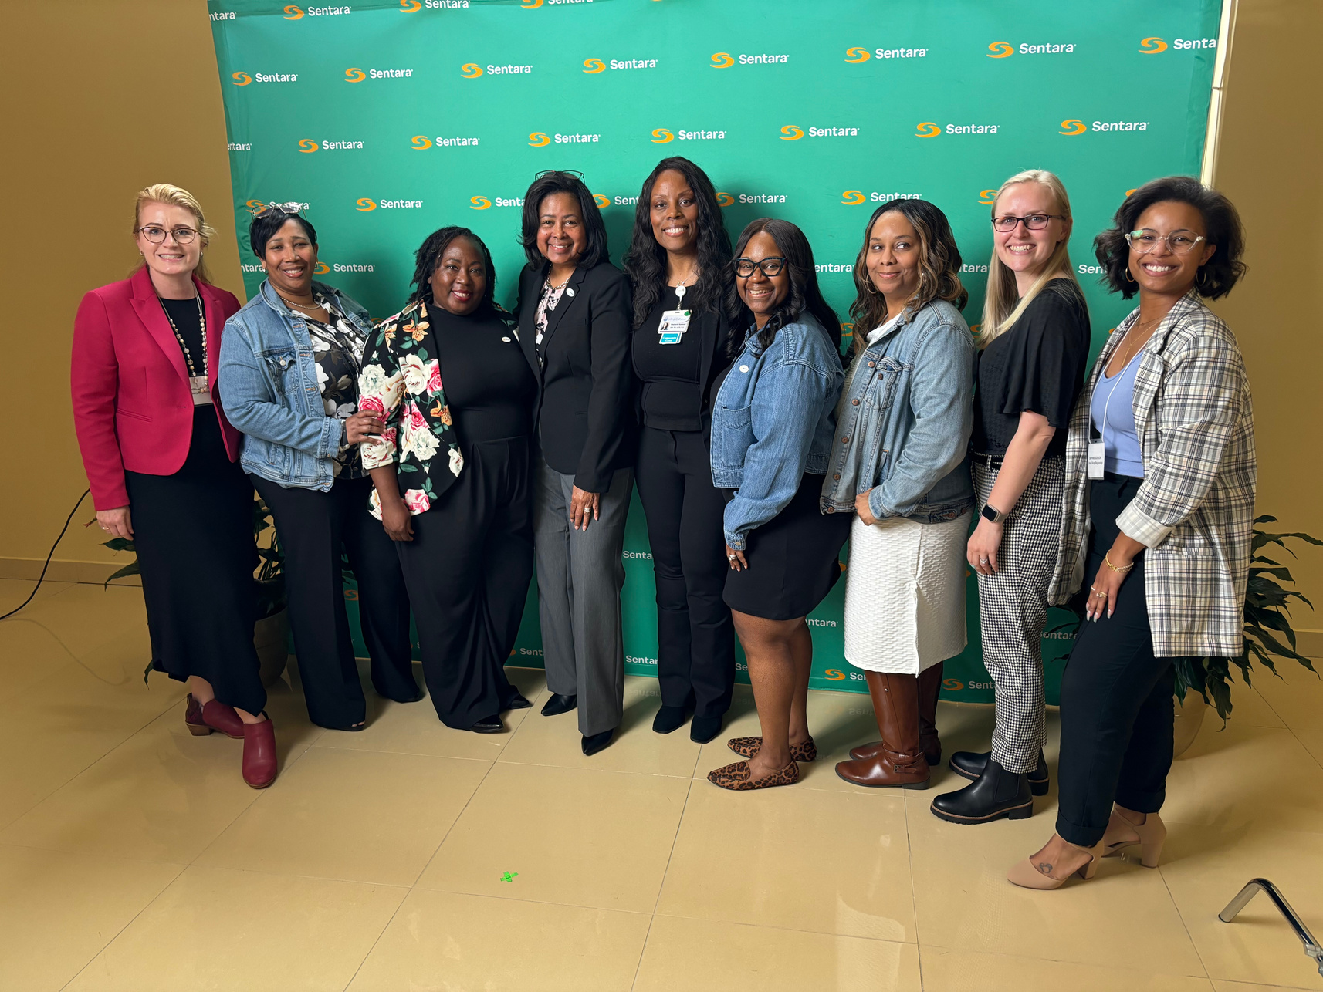
NORFOLK LANDSCAPE
BUILDING SAFER CHILDBIRTH CITIES

Slide 8
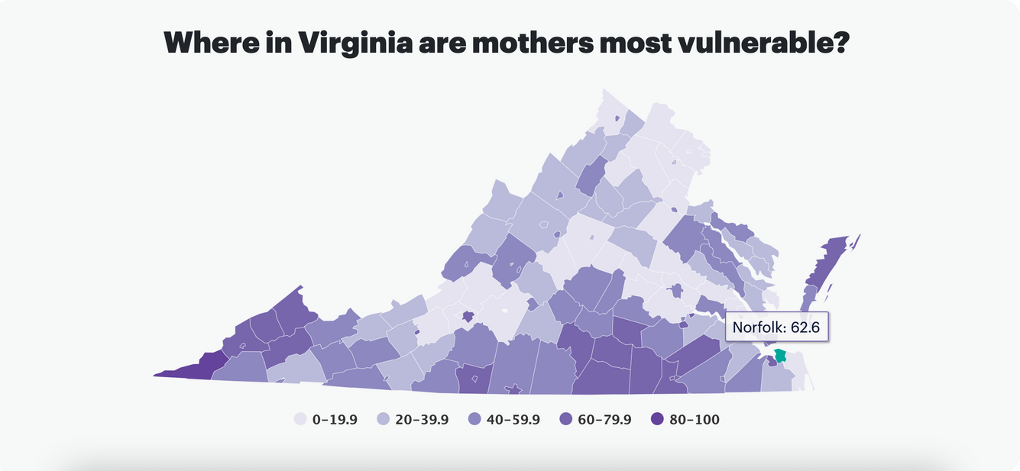
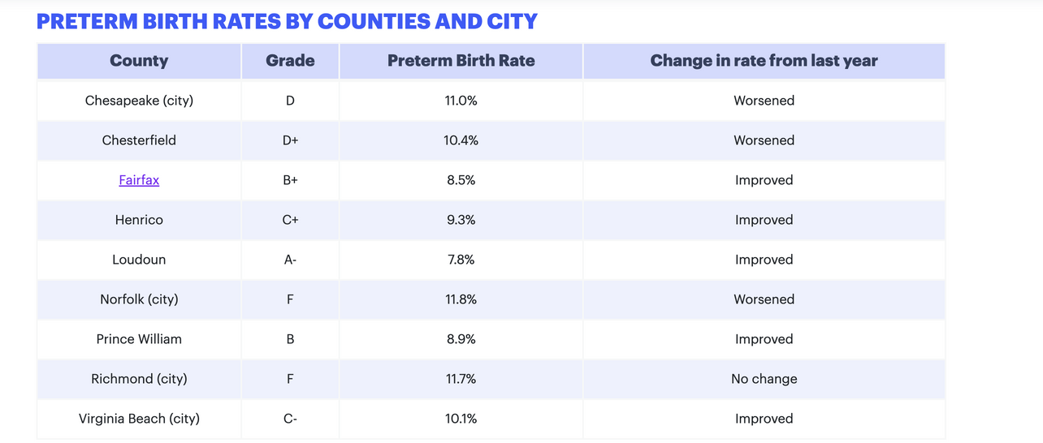
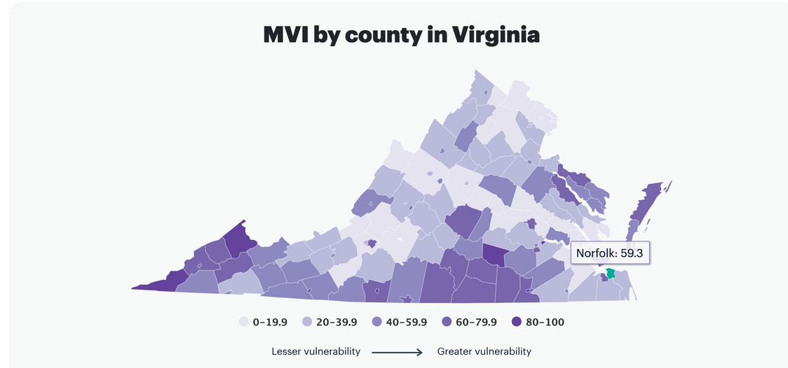

2022
Virginia Landscape
  High-Risk Population
  High Rates of SUD, Preterm Births, HTN/Preeclampsia, Mental Health Issues
  Social Factors (i.e. housing, transportation, economic, food insecurity)
  High Medicaid Population
2023
Urban Baby Beginnings | All Rights Reserved 2024

Slide 9
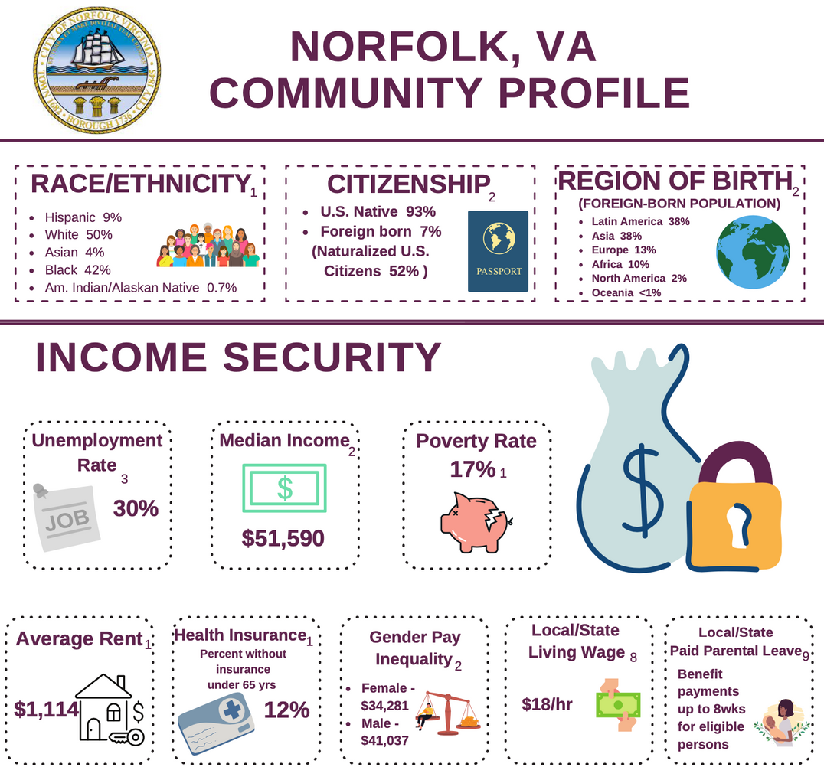
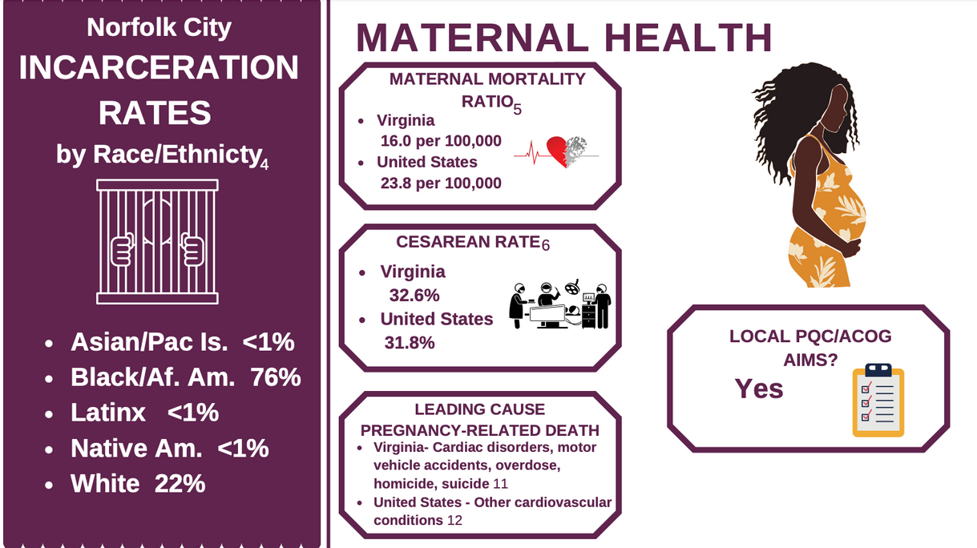

Hampton Roads Statistics
Presented by Stephanie Spencer 2024 Confidential and Proprietary

Slide 10
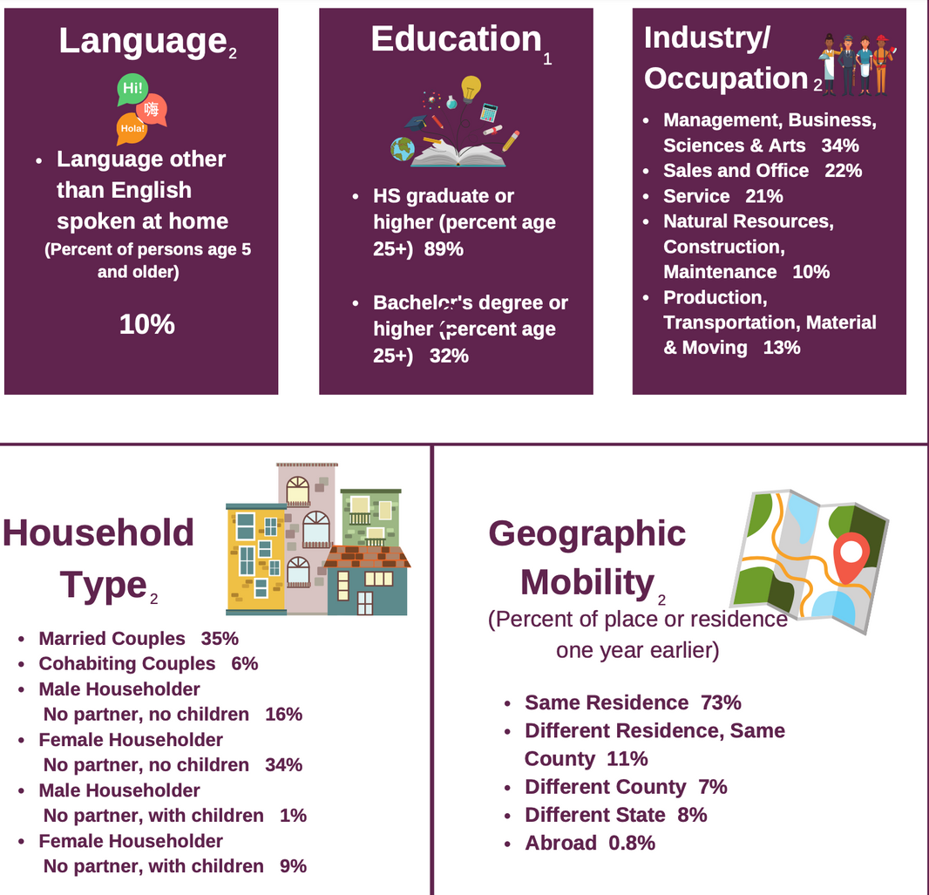
Hampton Roads Statistics
Presented by Stephanie Spencer 2024 Confidential and Proprietary

Slide 11
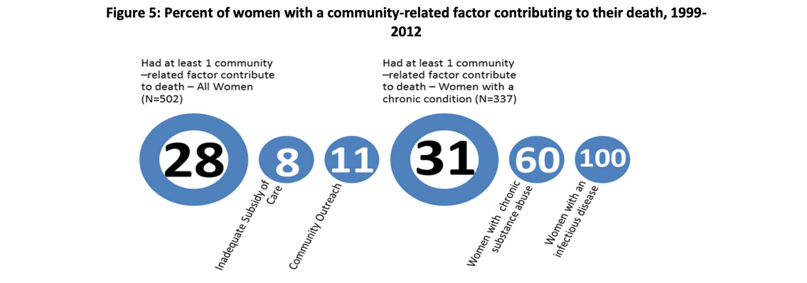
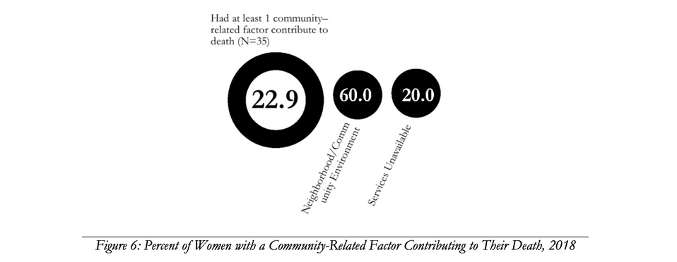
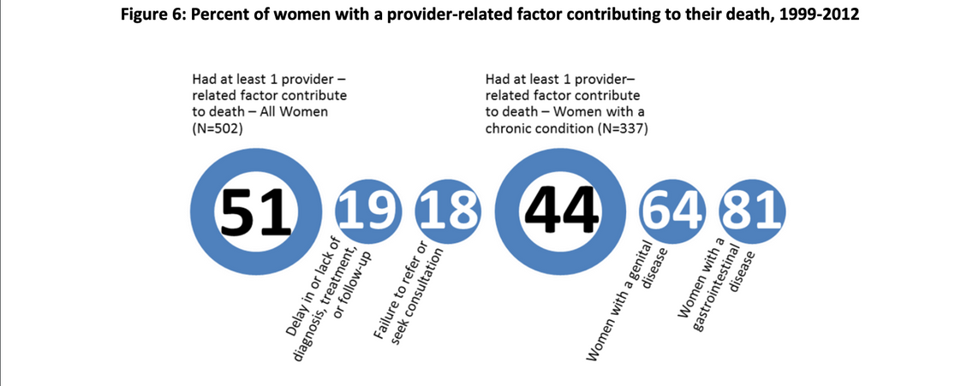
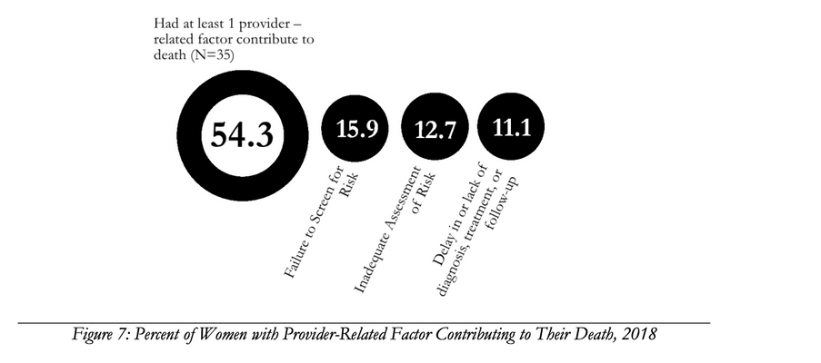
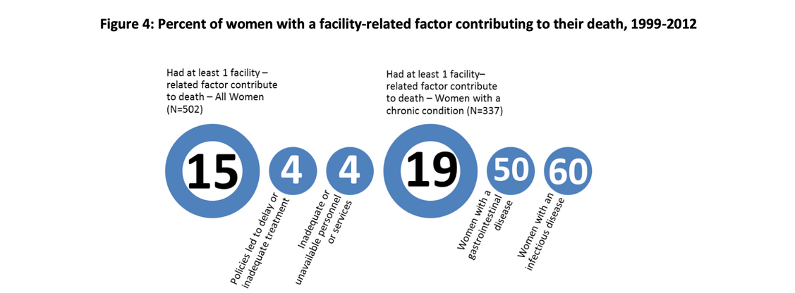
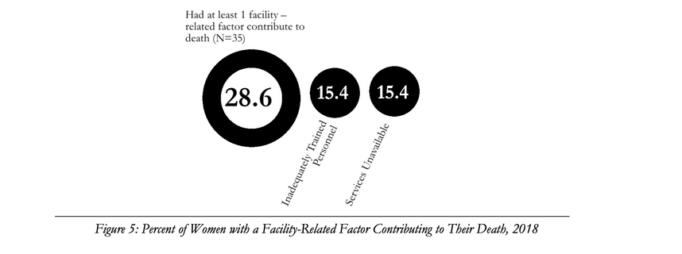
Maternal Mortality Review Team (MMRT) Reports
02
1999-2012
2018
Urban Baby Begnnings | 2024 All Rights Reserved

Slide 12
INTERNAL DATA

Slide 13
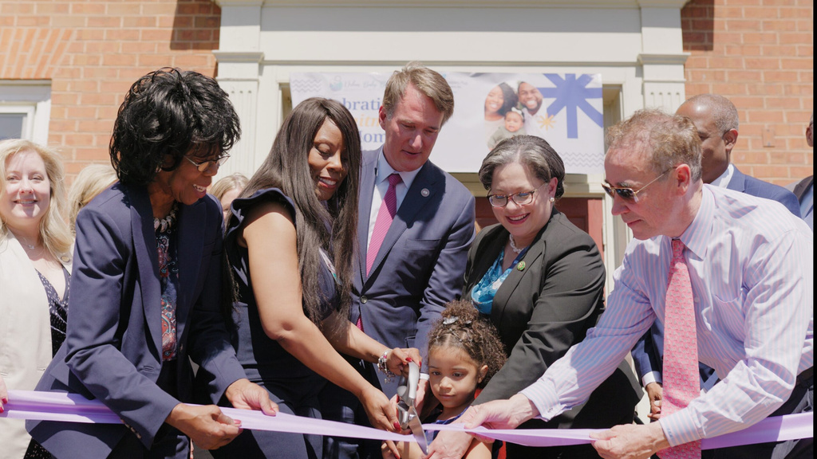
National Governor’s Association
  Develop public-private partnerships to implement place-based community-partnered change models in areas with the highest maternal and infant morbidity and mortality, and then expand to every community across the state.
  Develop a proposal for a state maternal health innovation (MHI) program through the federal health resources & services administration (HRSA) to support state planning and infrastructure.
  Expand evidence-based home visiting programs.
  Invest in programs that provide moms with low-income prenatal care, safe and affordable housing and access to nutritious food, and enhance access to reliable and safe public transportation.
  Develop certifications and allow Medicaid funding for perinatal peer support models.
  Promote the benefits of midwifery and community doula models of care.
  Strengthen the community health worker (CHW) workforce through certification and increased access to training.
  Support a statewide campaign to raise awareness of statistics, resources, and life-threatening signs during and after pregnancy.
  Implement prenatal and postpartum patient safety bundles to address ongoing quality improvement.
  Ensure access to comprehensive evidence-based childbirth education for all Medicaid beneficiaries as part of standard prenatal care.
Urban Baby Beginnings | 2024 All Rights Reserved

Slide 14

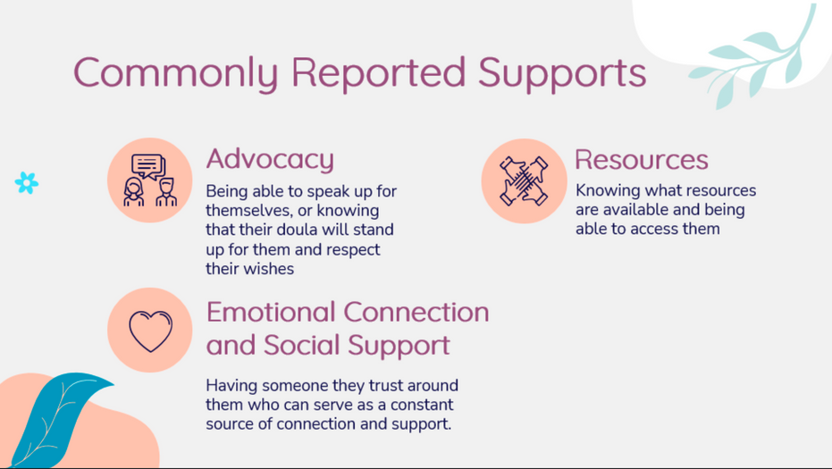
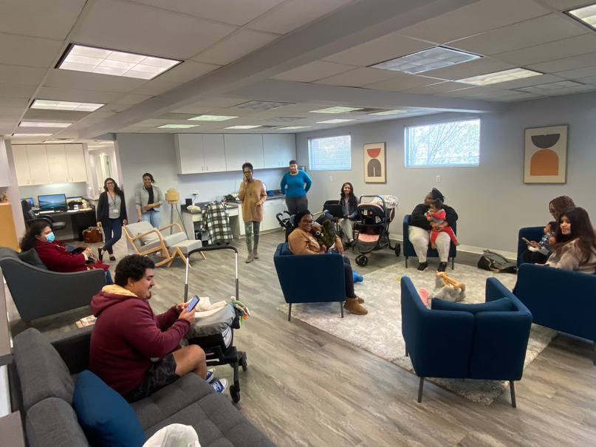
BEST PRACTICES
“Implementing policies that facilitate the coordination of care and patient navigation, inclusive of the identification of barriers to care and the provision of referrals to community resources to address the identified barriers,
is important.” (MMRT 2019)
“Maternal and child health experts have identified the
receipt of coordinated, collaborative, high-touch care (facilitated by case management and maternal health homes) for all perinatal persons as essential... All perinatal care should ideally take place in a “maternal health home” or “women’s health home” and should have a strong linkage to ongoing
primary care” (Commonwealth 2023)
Evidence-based home visiting is promoted as a “best practice” by the American Academy of Pediatrics (Commonwealth 2023)
“Pursue promising community-driven initiatives, that aim to reduce disparities in short-term (e.g., access to maternal healthcare), medium-term (e.g., breastfeeding and postpartum visits), and/or long-term outcomes (e.g., premature births and low birth weight infants)” (Surgeon General, 2020
Virginia Moms Agree, 2024 Survey of Support Needs
Urban Baby Beginnings | 2024 All Rights Reserved

Slide 15
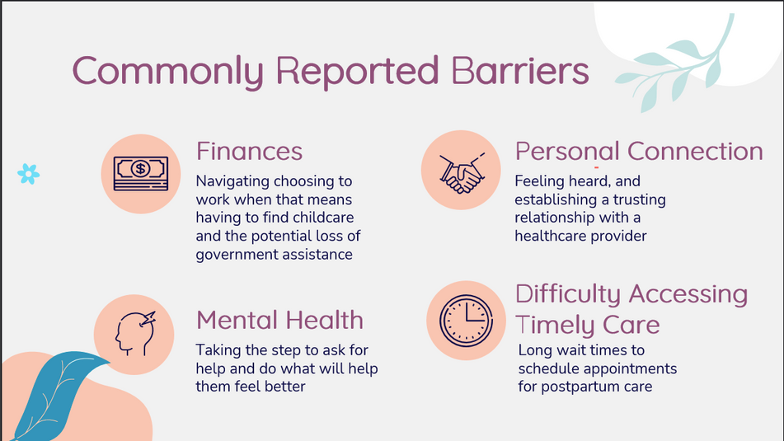
BEST PRACTICES
“Support and scale innovative approaches across the health care arena can improve maternal health outcomes through policies, technology, systems, products, services, delivery methods, and models of care (Surgeon General, 2020).”
“Growing evidence supports collective impact models as a highly effective strategy for addressing complex social problems resulting in improved health outcomes”(The Practical Playbook 2024)
“Engaging patients and communities in the design and implementation of interventions to improve maternal and infant health outcomes is crucial” (Meadows et al, 2023)
“Adopt and implement maternal safety bundles to improve outcomes at the hospital and community level” (Meadows et al, 2023)
Virginia Moms, 2024 Survey of Barriers Reported
Urban Baby Beginnings | 2024 All Rights Reserved

Slide 16

UPLIFT COMMUNITY VOICE
  In collaboration with the Virginia Neonatal Perinatal Collaborative, the state PQC, we have collected the voices of over 230 mothers voices
  Families discussed the lack of coordinated services as a predictor to negative birth outcomes and trauma
The “infusion of community voices and collaborative leadership” is critical to improving outcomes and empowering communities (MHLIC 2024)
Urban Baby Beginnings | 2024 All Rights Reserved

Slide 17
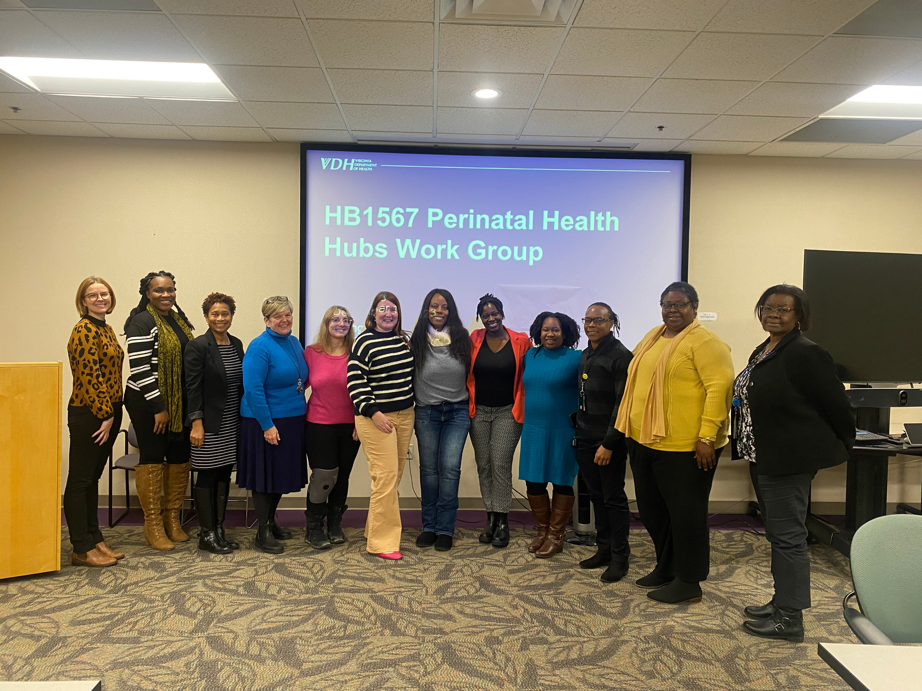
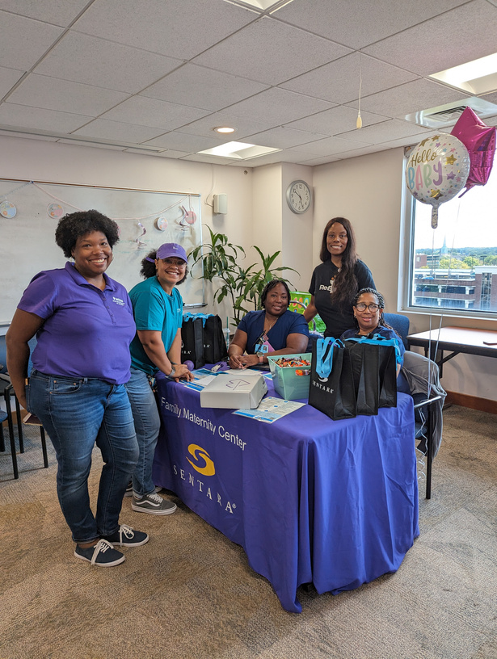
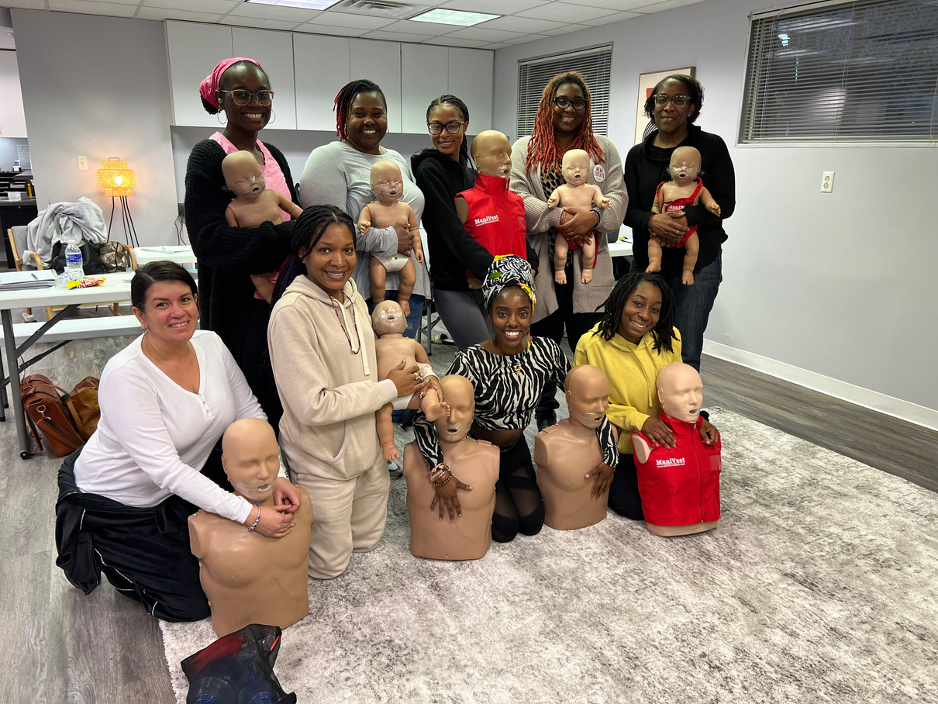
Collaboration
13
“Building and sustaining systems for maternal health requires the ability to track and weave together different programs and innovations, to realign funding streams and training models, and to advocate for needed changes, all centered on the leadership and guidance of engaged communities. There are no easy or quick fixes, nor one solution that works for all, but rather an opportunity to create enduring systems of maternal health for individuals and communities.” MHLIC & de Beaumont Foundation
Urban Baby Beginnings | All Rights Reserved 2024

Slide 18
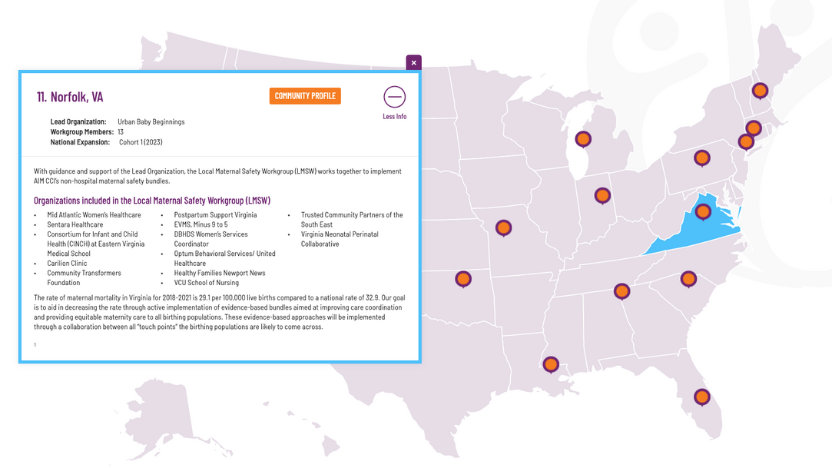
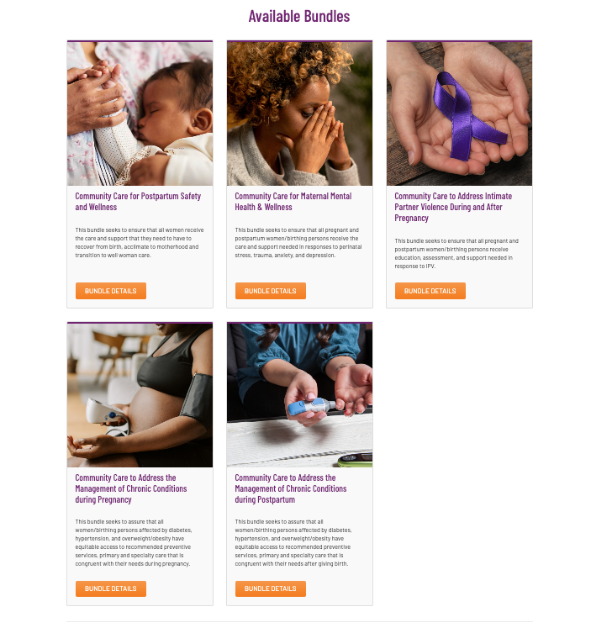
Building Safety: AIM CCI Safety Bundles
AIM CCI develops maternal safety bundles for use in non-hospital settings such as outpatient and community-based clinical facilities, as well as by other social and supportive services agencies that may be a touchpoint during the pregnancy and postpartum journey.
Urban Baby Beginnings | All Rights Reserved 2024

Slide 19
AIM CCI Safety Bundles
“By elevating the voice and wisdom of the community, we can close the gap between what care birthing persons need and what the clinical system offers.” Community Based Safety Bundles include:
  Community Care for Postpatum Safety and Wellness
  Communithy Care for Maternal Mental Health & Wellness
  Community Care to Address Intimate Partner Violence During and After Pregnancy
  Community Care to Address the Mangement of Chronic Conditions during Pregnancy
  Community Care to Address the Management of Chronic Conditions during Postpartum
Urban Baby Beginnings | All Rights Reserved 2024

Slide 20
BUILDING SAFER CHILDBIRTH CITIES- AN AREA INITIATIVE (3 YEAR ACHIEVEMENTS)
  Expanded care coordination program to include home visiting, doula support, and navigation services for Sentara Norfolk General in collab with Urban Baby Beginnings
  12-member ReByrth interdisciplinary team focused on strengthening support for birthing people of color
  Sentara Mobile Unit expansion to help connect families to care with an emphasis on prenatal care/support
  Established CNM midwifery-led healthcare - Sentara Health Systems
  Free Standing Easy Access midwifery clinic in Chesapeake, VA
  12+ community-based programs partnering with Sentara Health to ensure families are connected by addressing SDOH at the community level
  Launch of Center of Equity
  Established 2 maternal health hubs in Newport News and Norfolk
  Expansion of community-based perinatal programs into EVMS Newport News
  167 community-based doulas of color in the Hampton Roads area
  Launch of Black Maternal Health Equity Action Alliance
  5+ collective impact groups (lactation, SUD, home visiting, black maternal health, healthy homes)
  70+ community-based programs focused on birthing people and their families
  2 area diaper banks
  Peninsula and Tidewater Maternal Mental Health social support programs through PSVA
  Expansion of CHW programs through IPHI in partnership with NSU, ODU, Sentara, UBB
So what is missing?
Presented by Stephanie Spencer 2024 Confidential and Proprietary

Slide 21
NEXT STEPS

Slide 22


Contact Us
Address
PO Box 4255
Richmond, VA 23220
Phone
(833) 782-2229
Email
sspencer@urbanbabybeginnings.org
Urban Baby Beginnings | All Rights Reserved 2024

