Slide 1
Testing New Approaches in Medicaid: Section 1115
Demonstrations for Housing and Reentry Services
August 29, 2024
Speaker: Dori Glanz Reyneri

Slide 2
Housing instability and incarceration result in poor health outcomes
Individuals facing homelessness or housing insecurity or who are leaving incarceration have disproportionately higher rates of health conditions and are at higher risk for injury and death.
People who face housing instability are more likely to experience poor health in comparison to their stably housed peers.
Individuals who are unhoused are dying 20 years younger, with higher rates of injurious, treatable, and preventable causes of death.
Many individuals experience trauma on the streets or in shelters; this can result in long-standing impacts to psychological well-being, leading to persistently high health care expenditures due to Emergency Department (ED) and hospital use.
Barriers to health care contribute to an individual’s particularly high vulnerability to morbidity and mortality the first few weeks after release, especially from overdose.
Individuals who are incarcerated have higher rates of mental illness and chronic and other physical healthcare needs, including hypertension, asthma, tuberculosis (TB), Human Immunodeficiency Virus (HIV), Hepatitis B and C, arthritis, and sexually transmitted diseases, than the general population.
Substance use disorder (SUD) prevalence in carceral settings is estimated to be as high as 65%.
Sources: Deaths of profound despair: A retrospective cohort study of mortality among people experiencing homelessness | PLOS ONE; smd23003.pdf (medicaid.gov); Risk factors for all-cause, overdose and early deaths after release from prison in Washington state – ScienceDirect; Incarceration and Health: A Family Medicine Perspective (Position Paper) | AAFP

Slide 3
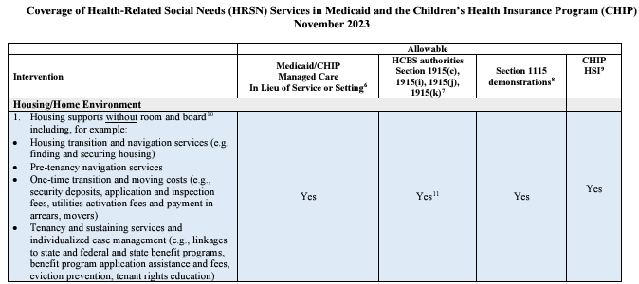
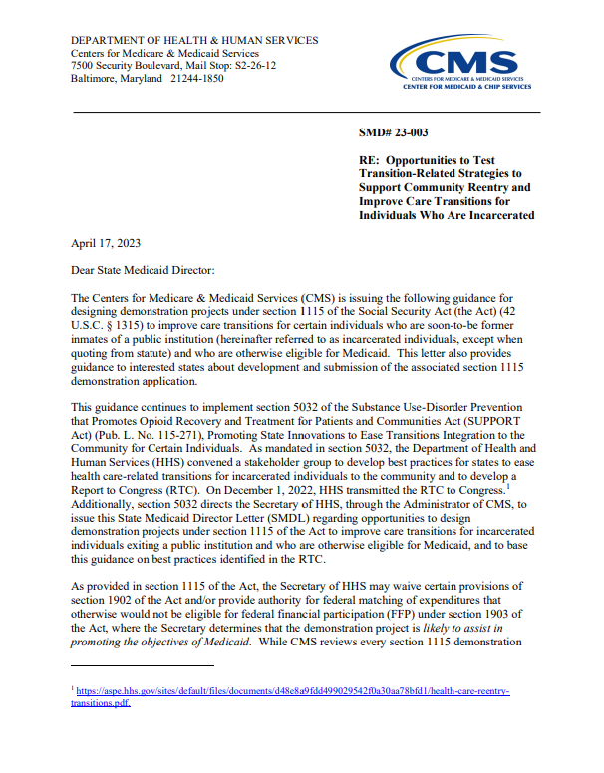
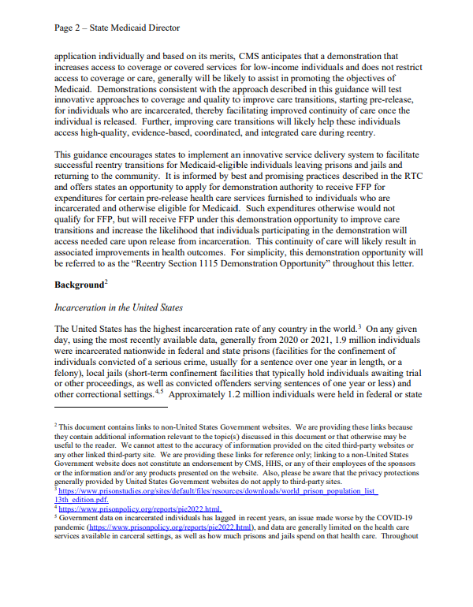
New federal guidance allows States to pursue 1115 demonstrations to address housing needs and provide reentry services to incarcerated individuals
Section 1115 of the Social Security Act gives the Secretary of Health and Human Services authority to approve State Medicaid demonstration projects that allow States to waive certain Medicaid requirements and/or spend Medicaid funds on costs that otherwise would not qualify for federal matching funds. 1115 Demonstrations must be budget neutral to the federal government and advance the objectives of the Medicaid Program.
Section 1115 Housing Services Demonstration Opportunity
In November 2023, CMS released an informational bulletin which indicates CMS will approve 1115 demonstrations that cover certain services that address enrollee health-related social needs (HRSNs), including interventions related to housing and home environment. CMS has also outlined guardrails on coverage of these services, such as limits on service duration and eligibility.
Section 1115 Reentry Demonstration Opportunity
In April 2023, CMS released a State Medicaid Director Letter (SMDL) that describes a section 1115 demonstration opportunity to support community reentry and improve care transitions for justice-involved populations. The SMDL allows states to waive the inmate exclusion and receive federal matching funds for expenditures for certain pre-release healthcare services provided to individuals who are incarcerated and otherwise eligible for Medicaid, prior to their release. The SMDL also outlines flexibilities and guardrails States must consider when designing and implementing these demonstrations

Slide 4
Medicaid’s role in addressing housing and reentry needs is focused on health
Housing and correctional partners and Medicaid have distinct but related missions; there is significant imperative and opportunity for alignment and collaboration to improve health for key populations.
The U.S. Department of Housing and Urban Development (HUD) is responsible for strengthening the housing market and supporting affordable housing.
State Department of Corrections (DOC) and local corrections agencies operate prison and jail facilities and meet the healthcare needs of inmates.
Medicaid is the primary program providing comprehensive coverage of health care and long-term services and supports for more than 90 million lower-income individuals.
Medicaid’s role in addressing housing insecurity and the needs of justice-involved populations is tightly connected to improving health outcomes.
Alignment and collaboration across Medicaid, HUD, correctional systems, and other local agencies and providers of services is critical to ensure these new Medicaid services successfully improve health for key populations.
Medicaid dollars may not replace and reduce total state spending on housing and corrections, but instead must supplement services to these populations.

Slide 5
States can cover a range of housing and housing-related services in Medicaid
To qualify for housing and housing-related services in Medicaid, an individual must have both a clinical need (e.g. a chronic condition) and a social need (e.g. homelessness or housing insecurity)
Services that can be covered under multiple Medicaid authorities, including 1115 Demonstrations
Services that can be covered only under Medicaid 1115 Demonstrations
HOUSING SUPPORTS
Housing transition and navigation services
Moving costs and deposits (including utility deposits)
Tenancy sustaining services
HOME MODIFICATIONS
Home remediations & accessibility
“ROOM AND BOARD”
Transitional rent
Short-term housing
Medical respite/post-hospitalization housing
Ongoing utilities
PROVIDER CAPACITY BUILDING
Technology
Workforce development
Development of business or operational processes
Outreach, education and stakeholder convening
Many of these services have been provided to HCBS populations for decades in some states
These must be short-term services (typically limited to 6 months)
1115 Demonstrations to Provide Housing Services and Pre-Release Services | Manatt, Phelps & Phillips, LLP

Slide 6
States also have flexibility to design the scope of reentry services in Medicaid
Services can be provided up to 90 days pre-release and are aimed at facilitating transitions back to the community.
Eligible Populations
Eligible Facilities
Eligible Services
States have flexibility to define their populations of focus (e.g., adults and/or youth in specified correctional facilities) for pre-release services
States have flexibility to establish specific eligibility criteria (e.g., individuals with SUD and/or SMI).
States may also consider making all Medicaid-enrolled individuals in participating carceral facilities eligible for pre-release services.
States have flexibility to provide coverage of pre-release services in state or local correctional facilities (e.g., state prisons, jails, and/or youth correctional facilities).
States may seek to provide services in all eligible correctional facilities statewide or in a subset of correctional facilities.
States may also use a phased approach to implementing reentry services over the course of the waiver.
States must cover three minimum mandatory reentry services:
Case management to assess and address physical and behavioral health needs, and HRSN
Medication Assisted Treatment (MAT)
30-day supply of prescription medications at point of release
States have flexibility to cover other important physical and behavioral health services, such as screenings, preventive services, and durable medical equipment
1115 Demonstrations to Provide Housing Services and Pre-Release Services | Manatt, Phelps & Phillips, LLP

Slide 7
States are taking different approaches to covering housing supports in Medicaid
CMS has been rapidly approving 1115 demonstrations under the new “HRSN” waiver framework, with more State requests pending approval.
Key
Oregon is designing a menu of HRSN services to address housing needs for individuals experiencing a life transition, including by providing climate-related devices or rent supports to certain high-risk individuals.
1115 waiver approved under CMS “HRSN framework”
* Additional HRSN 1115 waiver amendment(s) pending
WA*
NE
NV
UT
MT
ND
ME
CA
OR*
1115 waiver pending with HRSN provision(s)
MO
VT
ID
MN
NH
SD
WI
NY
MA
AZ
WY
OK
MI
RI
NM
CT
North Carolina provides the nation’s most extensive menu of HRSN services through regional pilots under its 1115 waiver approved by the Trump Administration (pending renewal would expand pilots statewide)
California authorizes some housing services using managed care ILOS authority, and others using 1115 waivers.
NE
IA
PA
NJ
NV
OH
DE
UT
IL
IN
D.C.
CA*
CO
WV
VA
MD
KS
MO
KY
TN
NC
AZ
NM
OK
Arizona is in the process of designing and implementing supportive housing services for individuals with SMI/SUD.
AR
SC
MS
AL
GA
Arkansas is targeting housing services to individuals with SMI or SUD who live in a rural area, have high-risk pregnancies, or are young adults at high-risk for long-term poverty and poor health outcomes
TX
LA
AK
FL
HI
Sources: Medicaid Waiver Tracker: Approved and Pending Section 1115 Waivers by State | KFF; Section 1115 Waiver Tracker Key Themes Maps | KFF

Slide 8
Many states have also submitted reentry demonstration requests
23 states and D.C. have submitted Reentry Demonstration requests. To date, 11 states have received CMS approval.
WA
MT
ND
ME
OR
VT
NH
ID
MN
MA
SD
WI
NY
WY
MI
RI
PA
NJ
CT
NV
NE
IA
UT
IN
OH
DE
CA
CO
IL
D.C.
KS
MO
WV
VA
MD
KY
TN
NC
AZ
NM
OK
AR
SC
Key
MS
AL
GA
TX
Reentry 1115 waiver approved
AK
LA
FL
Reentry 1115 waiver pending
HI
Sources: Medicaid Waiver Tracker: Approved and Pending Section 1115 Waivers by State | KFF; Section 1115 Waiver Tracker Key Themes Maps | KFF

