Slide 1
Fiscal State of State Medicaid Programs
CSG Medicaid Leadership Academy
August 28, 2024
Shelby Kerns
Executive Director
National Association of State Budget Officers

Slide 2
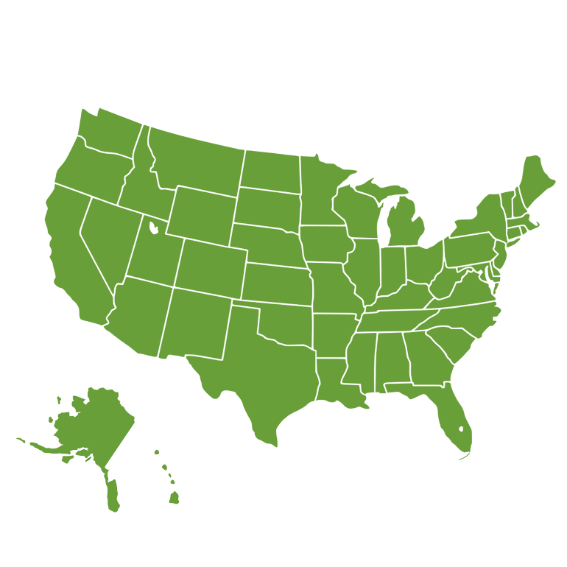
State General Fund Revenue Update
Trends in State Spending
State Savings Levels
Fiscal Outlook
Introduction to NASBO

Slide 3
Who is NASBO?
NASBO is an independent, nonpartisan, nonprofit research and educational organization. For nearly 80 years, NASBO has been the professional membership organization for budget and finance officers across all states, territories, and DC.

Slide 4
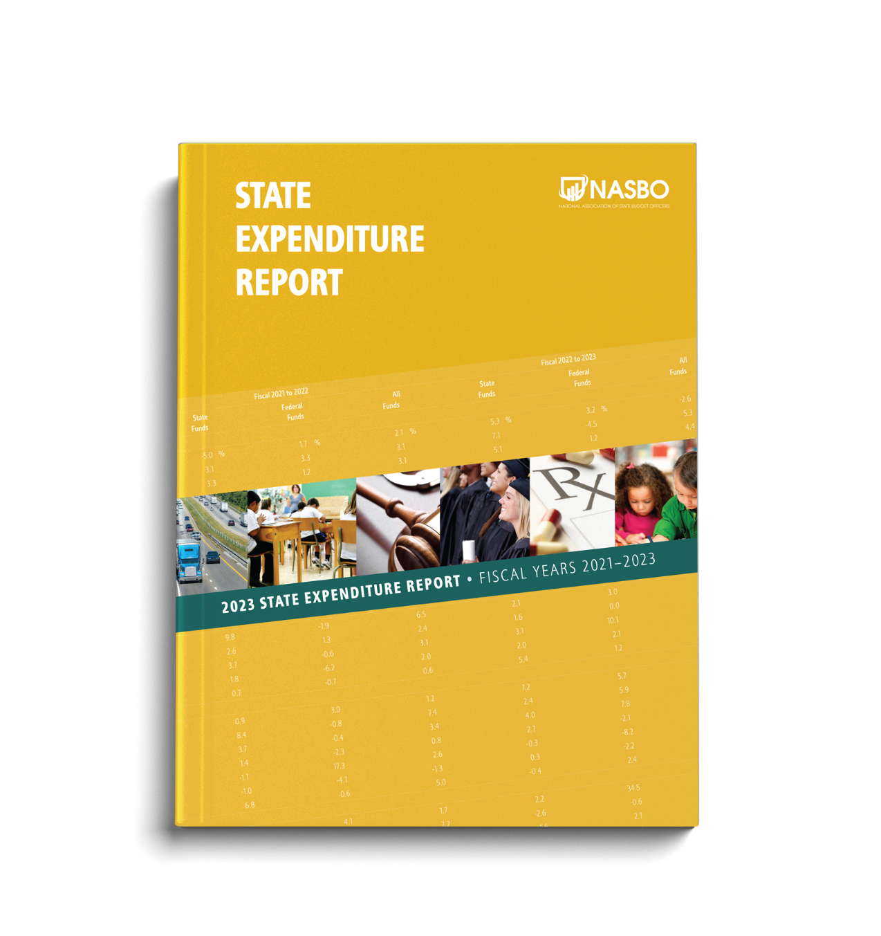
NASBO PUBLICATIONS:

Slide 5
State General Fund Revenue Update

Slide 6
Revenue Sources in the General Fund (%)
Estimated Fiscal 2023
NASBO Fiscal Survey of States

Slide 7
Annual General Fund Revenue Percentage Changes Fiscal 2007 to Fiscal 2025
NASBO Fiscal Survey of States

Slide 8
Net Tax Decreases Proposed in Fiscal 2025
Total Recurring Impact =
-$1,781 million
Total One-Time Impact =
-$706 million
NASBO Fiscal Survey of States
Fall 2023 Fiscal Survey of States

Slide 9
Annual General Fund Revenue (in Billions) Fiscal 2019 to Fiscal 2025
Note: Fiscal 2024 figure is estimated as of spring 2024 and fiscal 2025 figure is projected based on governors’ recommended budgets. Fiscal 2019 figure adjusted to account for change in reporting methodology for Ohio beginning in the Spring 2021 Fiscal Survey. Fiscal 2025 figure is adjusted to account for one state unable to report figures for that year.
NASBO Fiscal Survey of States

Slide 10
General Fund Revenue Collections
General Fund Revenue Collections Compared To Original Revenue Projections (By Fiscal Year)
*Fiscal 2024 is ongoing and figures are subject to change.
NASBO Fiscal Survey of States

Slide 11
Trends in State Spending

Slide 12
Annual General Fund Expenditure Percentage Changes Fiscal 2007 to Fiscal 2025
Note: Fiscal 2024 figure is estimated based on data reported in spring 2024; fiscal 2025 figure is based on governors’ recommended budgets.
NASBO Fiscal Survey of States

Slide 13
General Funds Expenditures
By Function
Estimated FY 2023
NASBO State Expenditure Report

Slide 14
TOTAL STATE EXPENDITURES
By Fund Source
Estimated FY 2023
Source: NASBO State Expenditure Report

Slide 15
Year-over-year Percentage Spending Growth
By Fund Source
*State funds are general funds and other state funds combined, excluding bonds. Total state expenditures are all federal and state funds.
NASBO State Expenditure Report

Slide 16
Total State Expenditures
By Function
Estimated FY 2023
NASBO State Expenditure Report

Slide 17
Federal Funds Expenditures
By Function
Estimated FY 2023
Source: NASBO State Expenditure Report

Slide 18
State Savings Levels

Slide 19
State Rainy Day Funds Fiscal 2000 to Fiscal 2025
Rainy Day Fund Balances in Dollars and as a Percentage of General Fund Expenditures
Note: Fiscal 2024 figure is based on estimated data; fiscal 2025 figure is based on governors’ recommended budgets. Total $ in billions amounts for fiscal 2024 and fiscal 2025 are adjusted to account for several states that were unable to report balances data for one or both years.
NASBO Fiscal Survey of States

Slide 20
State Total Balances Fiscal 2008 to Fiscal 2025
Total Balances in Dollars and as a Percentage of General Fund Expenditures
Note: Fiscal 2024 figure is based on estimated data; fiscal 2025 figure is based on governors’ recommended budgets. Total $ in billions amounts for fiscal 2024 and fiscal 2025 are adjusted to account for several states that were unable to report balances data for one or both years.
NASBO Fiscal Survey of States

Slide 21
State Fiscal Outlook

Slide 22
States are well prepared for a “rainy day”
A return to normal(ish) if you remember pre-covid, a new era of tight budgets if you don’t
Wind down of pandemic-era federal funding – states, local governments, school districts
General fund revenues closer to projections = less (or no) surplus revenue
Revenue Pressures: Impact of tax cuts as well as slowing inflation and economic growth on revenues
Budget Pressures: Medicaid, education, child care, housing, property tax relief, employee compensation
Fiscal
Outlook

Slide 23
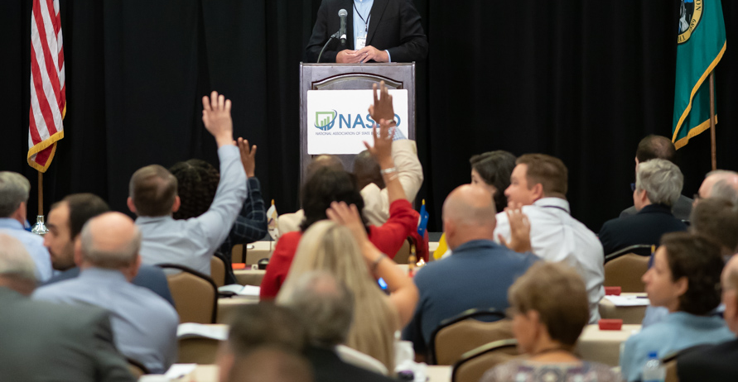
Thank you

