Slide 1
Behavioral Health Workforce Challenges August 28,2024 Clese Erikson, M.P.Aff.

Slide 2
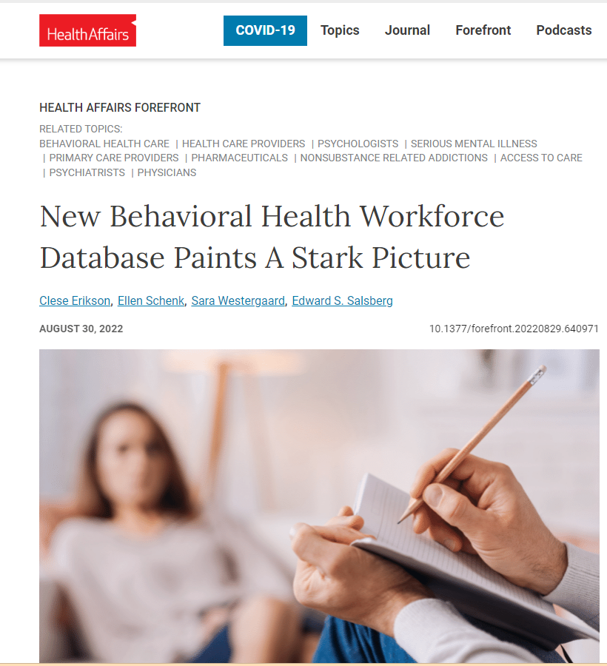
“It just hasn’t existed before.”
-- Clese Erikson, MPAff of George Washington University on a new database that mapped the U.S. behavioral health workforce
https://www.healthaffairs.org/content/forefront/new-behavioral-health-workforce-database-paints-stark-picture

Slide 3
Behavioral Health Workforce, 2021
Specialty | Number
Behavioral Health Specialists | 699,220
Psychiatric and Addiction Specialists | 52,969
Psychologists | 106,537
Counselors and Therapists (LCSW, LPC, MFT) | 539,714
Other Prescribers of Psychotropics and Medications for Opioid Use Disorder | 617,796
Primary Care Physicians | 219,126
Advanced Practice Providers | 215,799
Other Specialists | 182,871
Total | 1,317,016
Due to data limitations, excludes peer support providers, community health workers and substance use counselors.
Notes:
Notes: Prescribers with 11+ behavioral health medications (psychotropics and/or medications for opioid use disorder). Due to data limitations, psychiatric NPs and PAs are reported with other NPs and PAs. Includes fully licensed, active practitioners as of January 1, 2022. Does not include 24,019 psychologists and 80,217 counselors and therapists who had a practice address in a different state than they were licensed or could not be geocoded. Counts are deduplicated within state, but not across state. Due to data limitations, excludes peer support providers, community health workers and substance use counselors.

Slide 4
Stagnant growth between 2017-2021 except for APPs

Slide 5
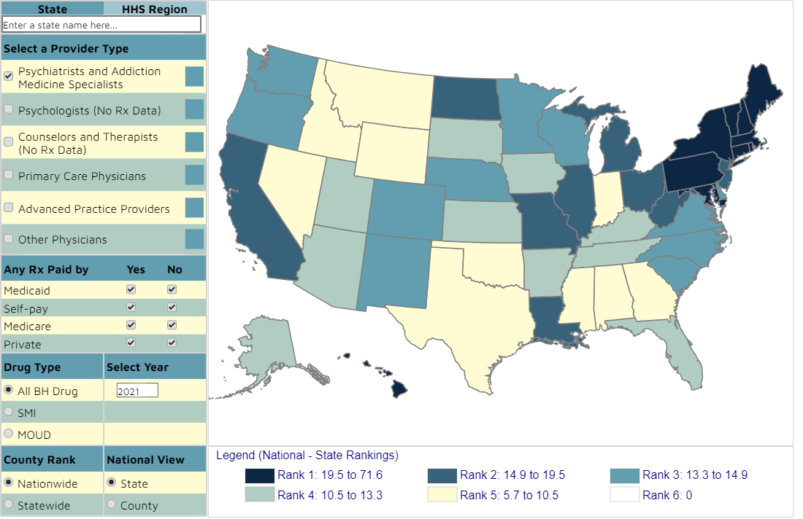
GW Behavioral Health Workforce Tracker
Source: GW Behavioral Health Workforce Tracker, https://www.gwhwi.org/behavioralhealth-workforce-tracker-v20.html

Slide 6
50% of counties do not have a psychiatric or addiction medicine specialist; PCPs fill gaps
Psychiatric and Addiction
Medicine Specialists
Primary Care Physicians that prescribe Psychotropics and/or MOUD
Source: GW Behavioral Health Workforce Tracker, https://www.gwhwi.org/behavioralhealth-workforce-tracker-v20.html

Slide 7
Access to pediatric specialists is even lower; major gaps even when including pediatricians
Child and Adolescent Psychiatrist
Pediatricians that prescribe psychotropics or MOUD
Source: GW Behavioral Health Workforce Tracker, https://www.gwhwi.org/behavioralhealth-workforce-tracker-v20.html

Slide 8
Get detailed data by hovering over a county
Psychiatric and Addiction (All)
714 providers
Psychiatric and Addiction (Any Medicaid Rx)
608 providers
Source: GW Behavioral Health Workforce Tracker, https://www.gwhwi.org/behavioralhealth-workforce-tracker-v20.html

Slide 9
In 2024, counselor and therapist workforce eligible to bill Medicare will expand to over half a million
Licensed Clinical Social Workers, 2021
Licensed Professional Counselors and Marriage and Family Therapists, 2021
N = 258,039
N= 281,675
Source: GW Behavioral Health Workforce Tracker, https://www.gwhwi.org/behavioralhealth-workforce-tracker-v20.html
Notes:
http://www.behavioralhealthworkforce.org/wp-content/uploads/2017/01/FA3P4_Billing-Restrictions_Full-Report.pdf

Slide 10
State variation in Medicaid provider eligibility
Psychiatric Diagnosis and Evaluation
Range 10 to 50 states by profession
Psychotherapy (30 min)
Range of 32 to 50 states by profession
Source: http://www.behavioralhealthworkforce.org/wp-content/uploads/2017/01/FA3P4_Billing-Restrictions_Full-Report.pdf

Slide 11
Growing role of NP/PAs in buprenorphine access

Slide 12
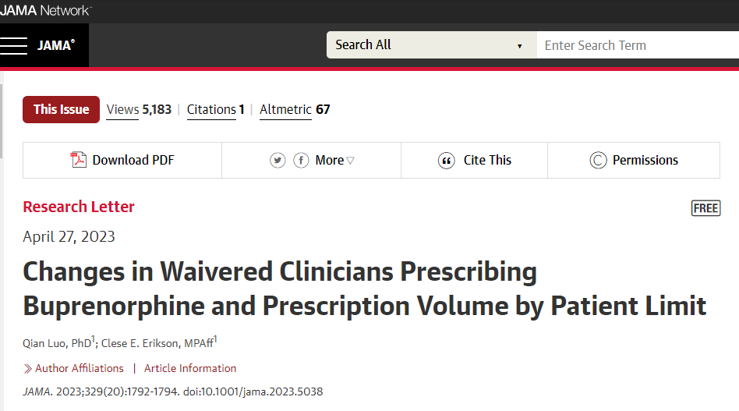
Limited participation in MAT

Slide 13
State variation in active DATA- Waivered prescribers, 2021

Slide 14
44 States allow direct billing for peer support services, but few beneficiaries receive
Nationally, only 1.9% of beneficiaries with a MH/SUD disorder had an individual claim for peer services in 2019

Slide 15
Integration of peer support specialists into Behavioral Health Facilities varies significantly by state
Highest States (11)
Idaho, Oregon | 58%
Mississippi | 55%
Oklahoma, Rhode Island, Wyoming | 52%
Georgia, Hawaii | 51%
New Hampshire | 50%
Texas, Washington | 49%
Mid-Range States (12)
Iowa | 30%
Minnesota, North Carolina | 31%
West Virginia | 32%
Washington, DC, Nevada, New York | 33%
Florida | 34%
Arkansas, Delaware, Kansas | 36%
Virginia | 38%
Lowest States (12)
Wisconsin | 16%
Alabama, North Dakota, South Dakota | 23%
Alaska, Maryland, New Jersey, Nebraska | 25%
Indiana, Louisiana, Ohio, Utah | 26%
Source: N-MHSS 2020, Elizabeth Dutta Dissertation
Notes:
Table 3. States with the Highest, Mid-Range, and Lowest Peer Support Penetration (N-MHSS 2020)

Slide 16
Role of Community Colleges, HBCUs and HSIs in diversifying graduates of BH Masters/PhD programs
Increased coordination between health professions programs and community colleges, HBCUs, and HSIs would expose students to health professions careers, identify career pathways, create mentorship opportunities and successfully complete prerequisites.
Not for citation – submitting for peer review publication

Slide 17
Need for cross sector collaboration
Accountable communities for health are one strategy for bringing together health systems, FQHCs, public health, social service agencies, schools and other community partners.
Identify community resources and how to share information, including documenting gaps in care.
Ultimately, this type of collaboration can move a community from addressing downstream problems to addressing the source of the problem upstream.

Slide 18
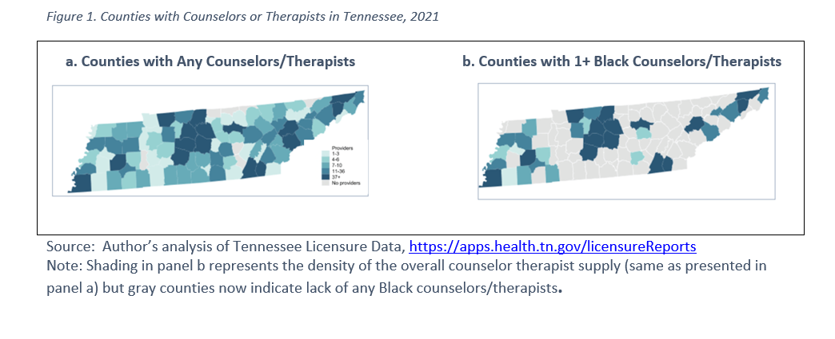
Collect and Liberate your Data!

Slide 19
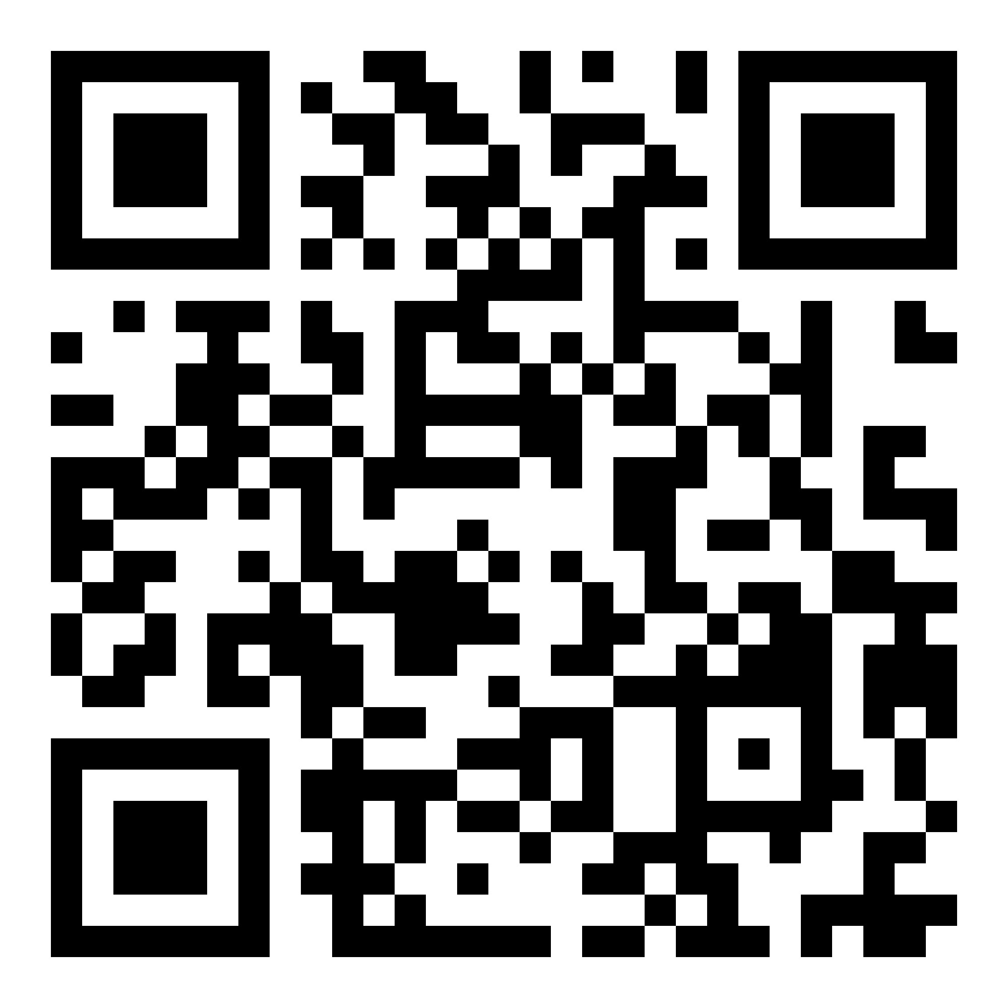
https://www.gwhwi.org/behavioralhealth.html
GW Behavioral Health Workforce Tracker
SCAN ME

Slide 20
Clese Erikson, MPAff
cerikson@gwu.edu
202-994-4122

