Slide 1
Medicaid in 2025: A Look at the Year Ahead
Robin Rudowitz
Director, Program on Medicaid and the Uninsured

Slide 2
Medicaid plays a central role in our health care system.
Health Insurance Coverage for 1 in 5 Americans
Assistance to 12.5 Million Medicare Beneficiaries
>50% LTSS Financing
MEDICAID
Financing for States & Health Safety-Net
Leverage to Help Address Key Health Challenges (SDOH, Maternal Health, Behavioral Health)

Slide 3
The basic foundations of Medicaid are related to the entitlement and the federal-state partnership.
Eligible Individuals are entitled to a defined set of benefits
Entitlement
States are entitled to federal matching funds
Federal
State
Sets core requirements on eligibility and benefits
Flexibility to administer the program within federal guidelines
Partnership

Slide 4
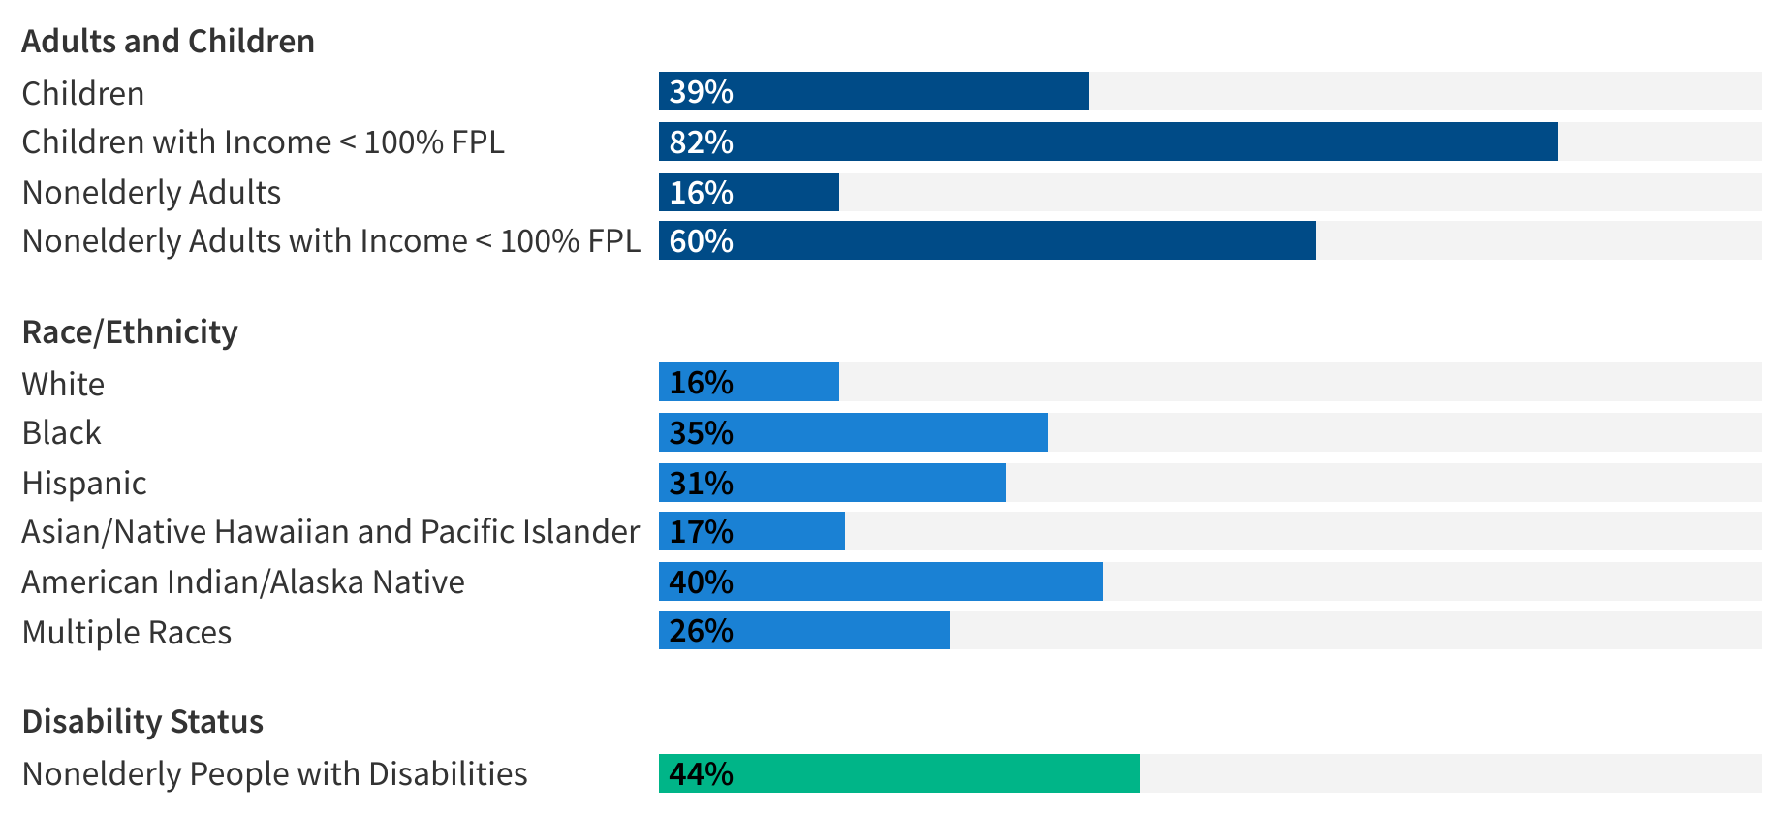
Medicaid plays an important role for certain populations.
Percentage of people within a group who have Medicaid
Note: FPL = federal poverty level. Estimates include the civilian, non-institutionalized population. Disability is defined as having one or more difficulty related to hearing, vision, cognition, ambulation, self-care, or independent living.
Source: KFF estimates based on the 2022 American Community Survey, 1-Year Estimates

Slide 5
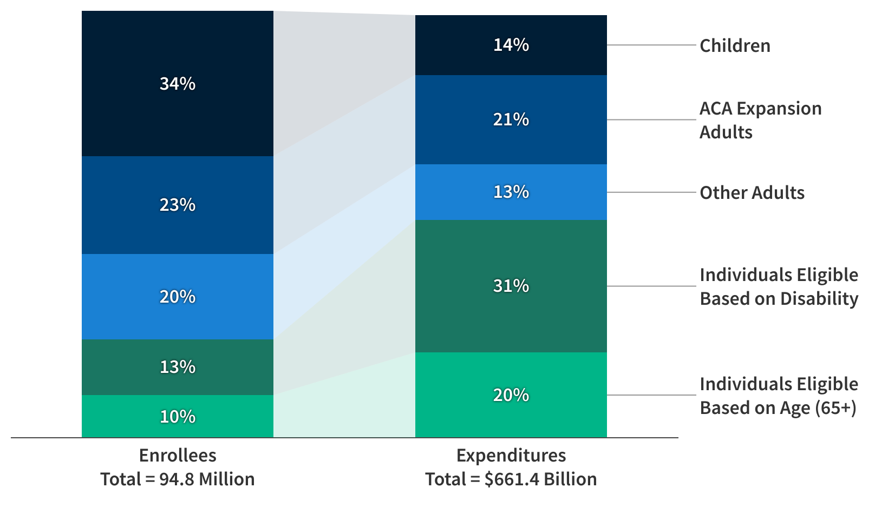
Medicaid spending is mostly for people who qualify on the basis of age or disability.
Note: Totals may not sum to 100% due to rounding.
Source: KFF analysis of the T-MSIS Research Identifiable Files, CY 2021
Notes:
- Who is enrolled in Medicaid and where is spending concentrated

Slide 6
What are the key Medicaid issues to watch in 2025?
Coverage and financing
Implications from unwinding of continuous enrollment
Medicaid expansion
Access
Expansion of benefits
Efforts to address SDOH
LTSS
Reimbursement rates
Workforce
External factors
State fiscal issues
State and federal election outcomes

Slide 7
COVERAGE AND FINANCING

Slide 8
The pandemic and pandemic-era policies had significant implications for Medicaid spending and enrollment.
Percent Change in Medicaid Spending and Enrollment, FY 1998-2024
Note: Growth percentages refer to state fiscal year (FY). FY 2024 projections based on enacted budgets.
Source: Medicaid Enrollment and Spending Growth Amid the Unwinding of the Continuous Enrollment Provision: FY 2023 & 2024.

Slide 9
Medicaid enrollment increased during the pandemic under continuous enrollment but has declined since April 2023.
Total Medicaid/CHIP Enrollment, February 2020 to April 2024
Note: M = Millions Source: KFF analysis of CMS Performance Indicator data.

Slide 10
As of August 2024, 41 states including DC have expanded Medicaid.
Source: KFF, Status of Medicaid Expansion Decisions: Interactive Map

Slide 11
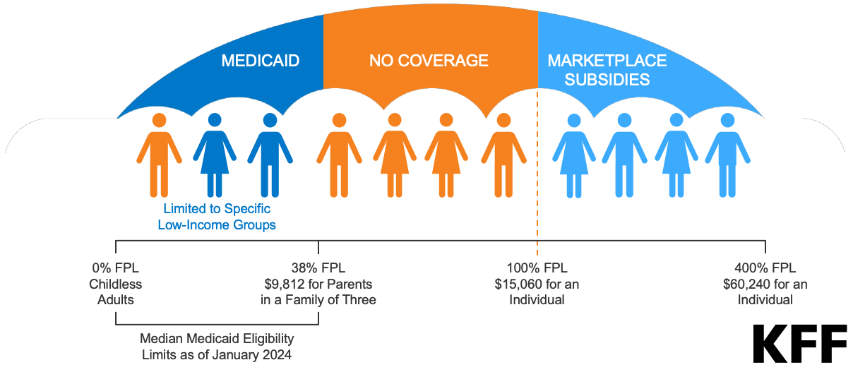
In the remaining ten non-expansion states, an estimated 1.5 million individuals fall into the coverage gap.
Source: KFF, How Many Uninsured Are in the Coverage Gap and How Many Could be Eligible if All States Adopted the Medicaid Expansion?

Slide 12
ACCESS

Slide 13
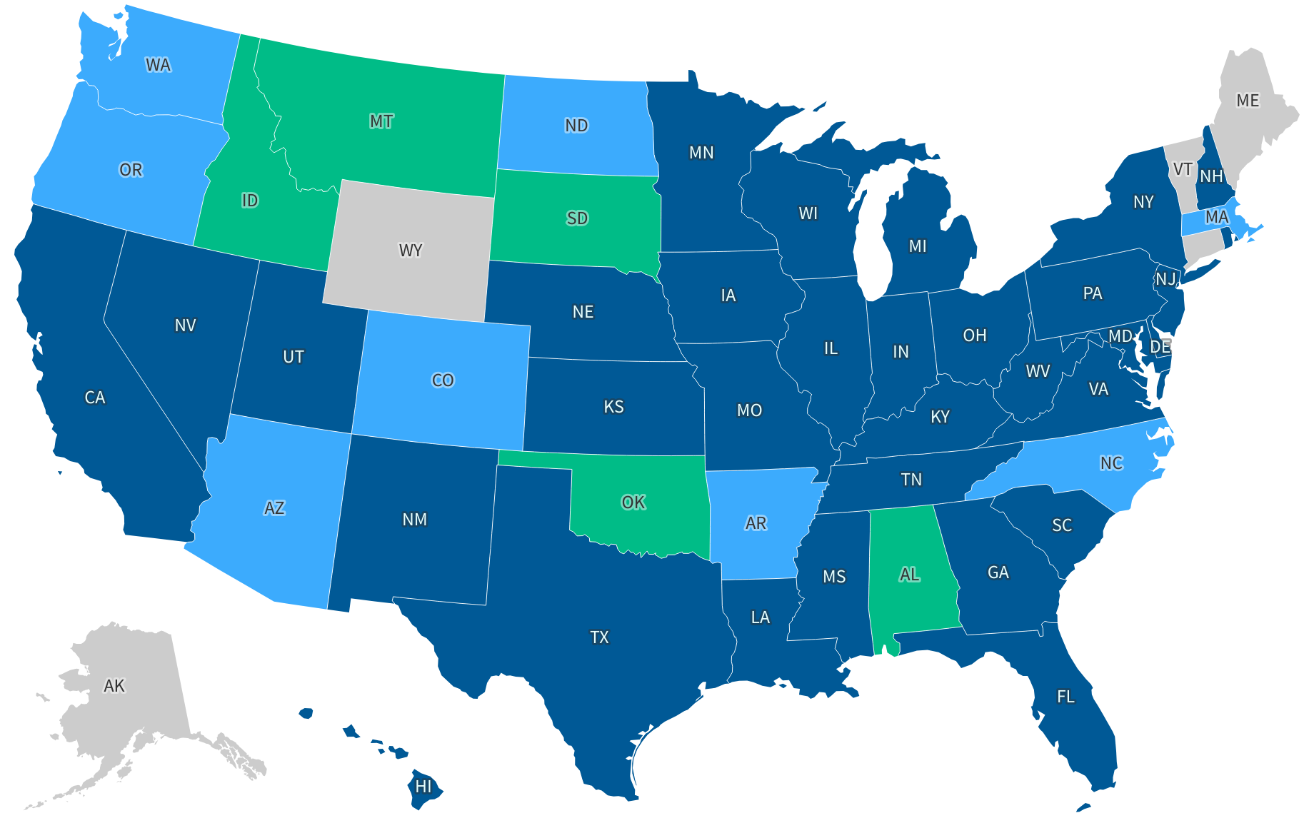
As of July 2023, 41 States used capitated managed care models to deliver services in Medicaid.
Comprehensive Medicaid Managed Care (MMC) Models in States as of July 1, 2023
MCO only (33 states including DC)
MCO and PCCM (8 states)
PCCM only (5 states)
No comprehensive MMC (5 states)
Source: KFF annual Medicaid budget survey, November 2023

Slide 14
Almost all responding MCO states reported requiring at least one SDOH-related contract requirement.
Note: n = 37 responding MCO states. Response rates per policy varied. *ICD-10 Z codes are a subset of the ICD-10 diagnosis codes that reflect patient social characteristics. Source: KFF annual Medicaid budget survey, November 2023

Slide 15
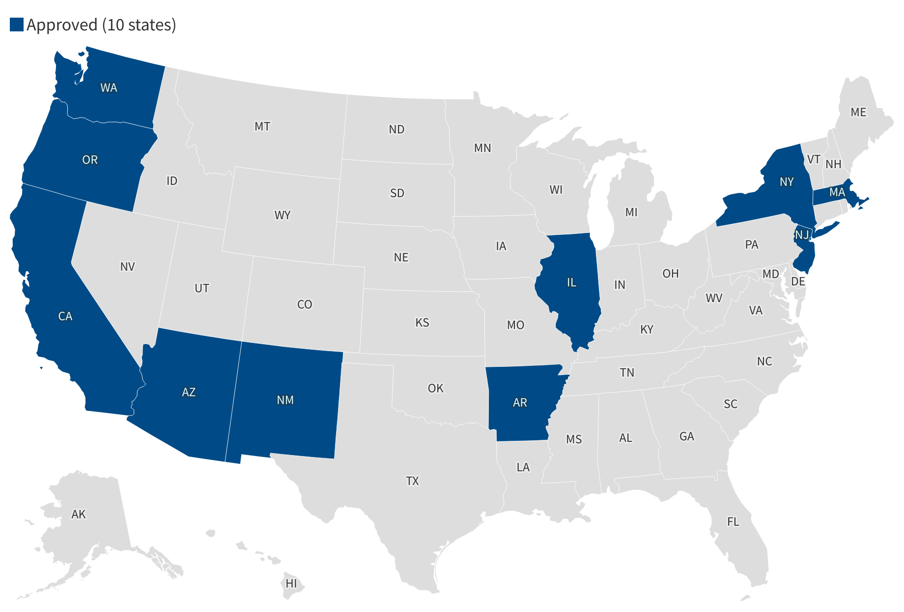
Ten states have waivers approved under recent health-related social needs framework.
Source: KFF Medicaid Waiver Tracker

Slide 16
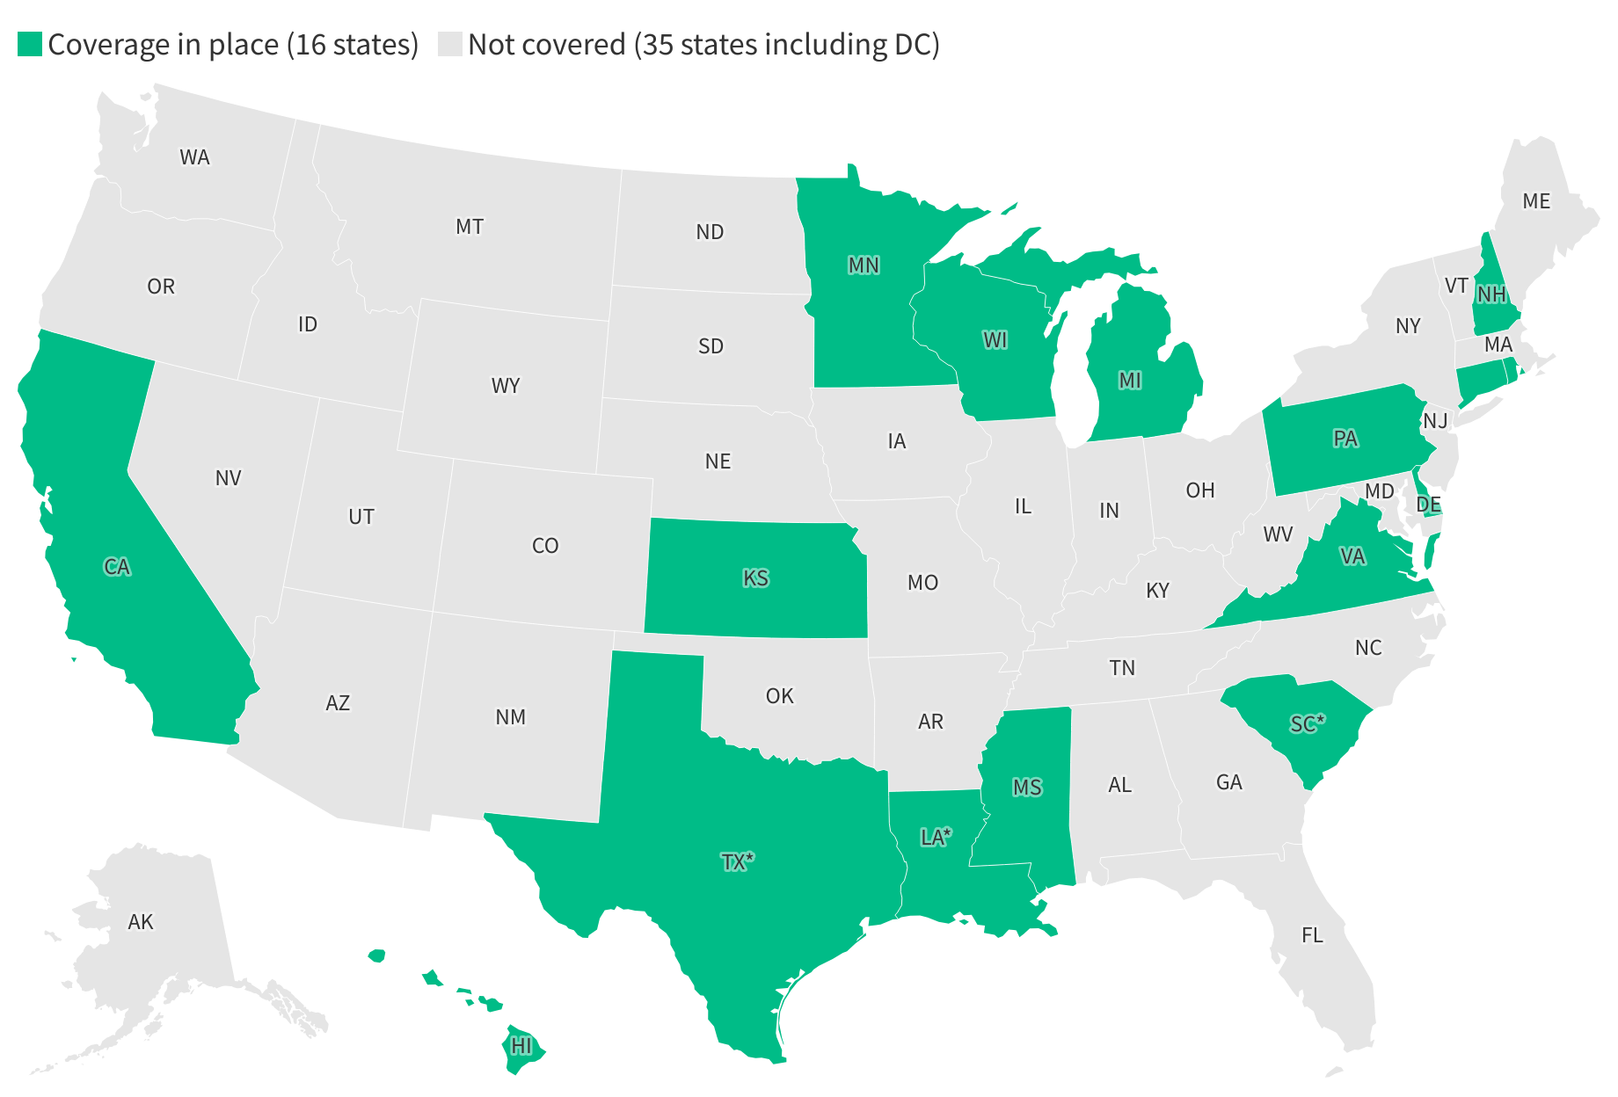
As of July 2023, 16 states reported covering at least one weight-loss medication for the treatment of obesity for adults.
Note: *At least three states, either in survey responses or publicly available data, noted coverage was limited to one drug (Orlistat/Xenical). Source: KFF annual Medicaid budget survey, November 2023

Slide 17
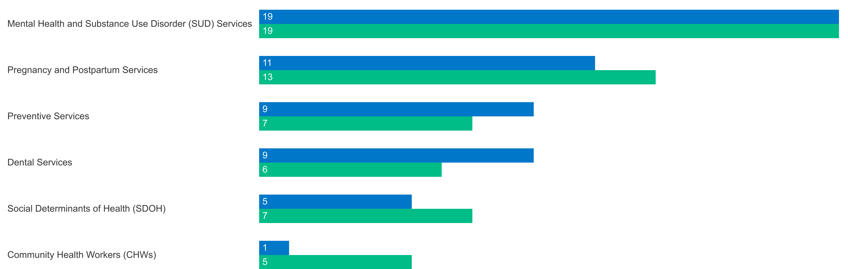
Almost all reported benefit changes were expansions, with mental health / SUD expansions the most common.
Select Categories of Benefit Enhancements or Additions, FYs 2023 - 2024
Note: SUD = substance use disorder. FL, MN, and SC did not respond to the 2023 survey.
Source: KFF annual Medicaid budget survey, November 2023

Slide 18
LTSS

Slide 19
Medicaid paid for more than half of US spending on long-term services and supports (LTSS) in 2022.
Source: KFF estimates based on 2022 National Health Expenditure Accounts data from CMS, Office of the Actuary

Slide 20
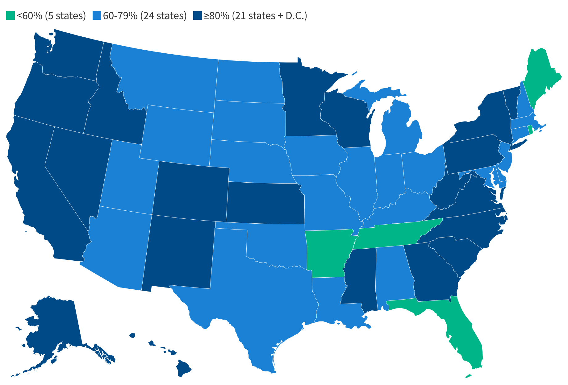
In nearly all states, the majority of people who use LTSS are using home and community-based services.
Share of Medicaid enrollees who used any HCBS among those who used any LTSS in 2021
<60% (5 states)
60-79% (24 states)
≥80% (21 states + D.C.)
Source: KFF analysis of the T-MSIS Research Identifiable Files, 2021

Slide 21
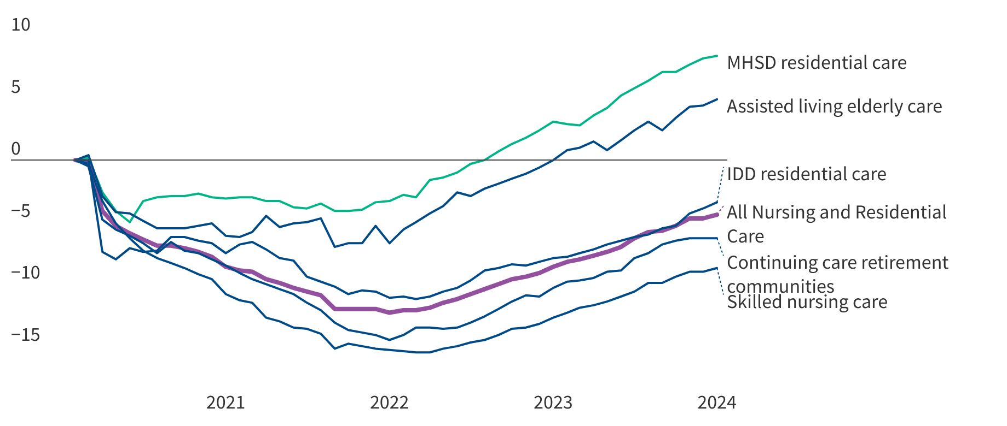
Workforce shortages among LTSS providers were exacerbated by the COVID-19 pandemic.
Cumulative % change in health sector employment, nursing and residential care facilities, February 2020 - January 2024
Note: IDD= Residential intellectual and developmental disability facilities. MHSD= Residential mental health and substance use disorder facilities.
Source: Peterson-KFF Health System Tracker

Slide 22
States reported fee-for-service rate increases for nursing facilities and HCBS providers more than for other provider categories.
FFS Provider Rate Increases Adopted for FY 2024
Note: HCBS = home and community-based services. Provider payment restrictions include rate cuts for any provider or freezes for nursing facilities or inpatient hospitals. FL, MN, and SC did not respond to the 2023 survey. Source: KFF annual Medicaid budget survey, November 2023

Slide 23
EXTERNAL FACTORS

Slide 24
States report uncertainty in their fiscal outlook, and state tax revenues are beginning to decline following years of strong growth.
Year-over-Year Percent Change in the 12-Month Rolling Average Total State Tax Revenue, Jan ‘21- May ‘24
Source: State Tax and Economic Review Project, State and Local Finance Initiative at Urban Institute. From KFF’s Medicaid and State Financing: What to Watch in Upcoming State Budget Debates.

Slide 25
New court rulings create uncertainty for Medicaid going forward.
The Supreme Court overturned Chevron deference a 40-year- old standard for decision making that required federal courts to defer to reasonable agency decisions where federal law is silent or unclear.
Major uncertainty ahead about final regulations, future litigation, responses by states and other stakeholders.
Key Medicaid regulations:
Eligibility
Access
Nursing facility staffing

Slide 26
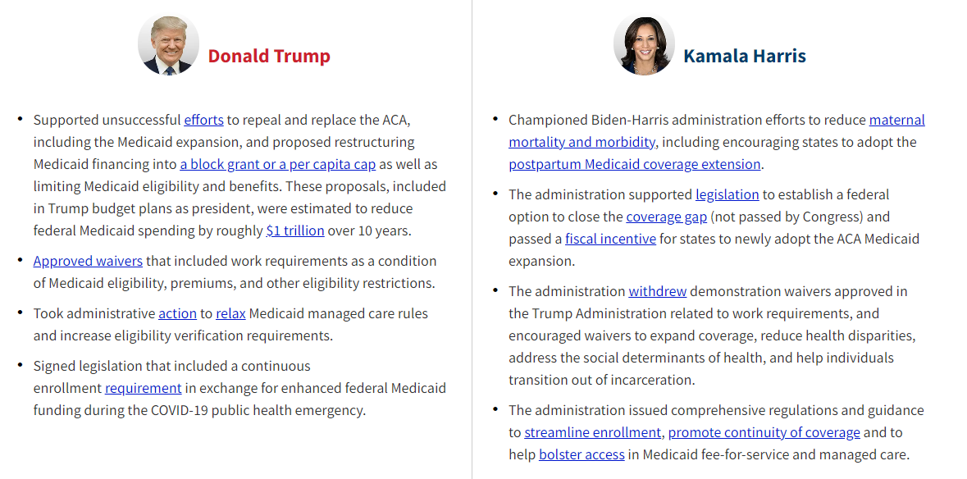
How may the upcoming election affect Medcaid policy?
Source: KFF, Election 2024 Compare the Candidates on Health Care Policy

Slide 27
THANK YOU
For more information, contact: robinr@kff.org

