Slide 2
Medicaid Innovation: Perinatal Health, MCO Trends, and Redetermination Impacts
Anna Bonelli, MURP
2

Slide 3
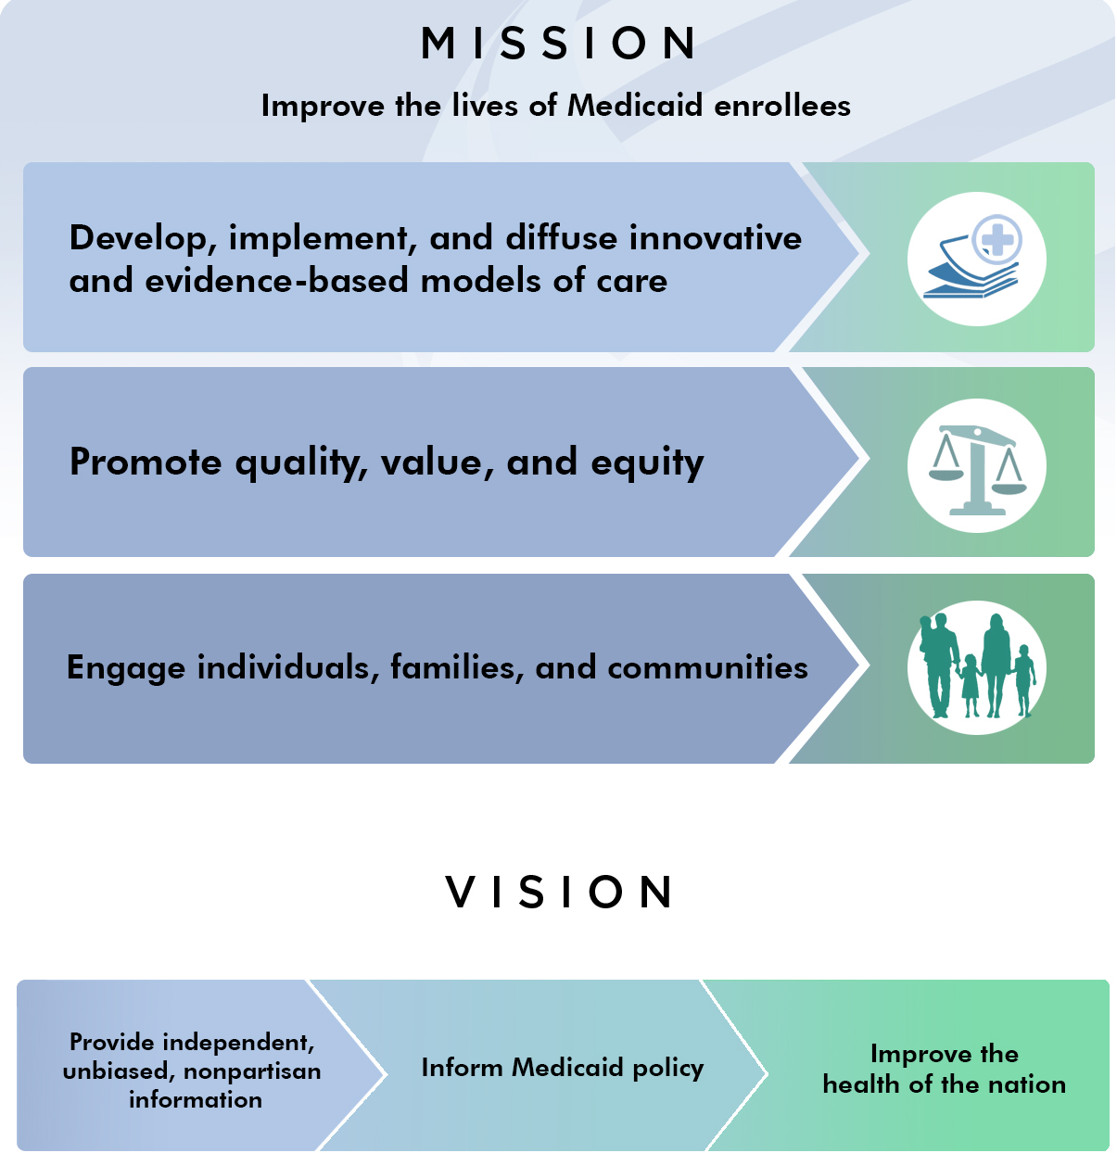
3

Slide 4
IMI Strategic Priorities
Access, Coverage, and Outcomes
Community and Equity
Data and Quality
Sustainability
4

Slide 5
Emerging Topics
Women and Gender Health
Behavioral
Health
Convening Meetings
Policy Analysis
Qualitative and Quantitative Research
Dissemination of Evidence and Best Practices
Collaborative Learning
Best
Practices
Knowledge Development
IMI Strategic Priorities
Annual Survey
Multi-Stakeholder Engagement
Facilitate Collaboration & Partnerships
Toolkits
Technical Assistance
Highlight Innovative Solutions
Child
Health
State Facts
Disparities
& Equity
5

Slide 6
6

Slide 7
Medicaid Innovation
Medicaid Snapshot

Slide 8
Medicaid
Medicaid Snapshot
Who is Covered
How it is Funded
81.7 M
individuals use Medicaid for health insurance coverage
Medicaid is jointly funded by federal and state funds.
States pay for services through fee-for-service or managed care arrangements.
More than 70%
enrolled in managed care
Medicaid.gov. (2024, April). April 2024 Medicaid and CHIP Enrollment Trends Snapshot, https://www.medicaid.gov/medicaid/program-information/medicaid-chip-enrollment-data/medicaid-and-chip-enrollment-trend-snapshot/index.html
CMS.gov, (2024, April 22). Medicaid and Children’s Health Insurance Program Managed Care Access Finance and Quality Final Rule (CMS-2439-F), https://www.cms.gov/newsroom/fact-sheets/medicaid-and-childrens-health-insurance-program-managed-care-access-finance-and-quality-final-rule#_ftn1

Slide 9
Medicaid: Who is Eligible?
Medicaid Snapshot
Medicaid is the single largest source of health coverage in the United States.
Medicaid, in conjunction with the Children’s Health Insurance Program (CHIP), provides health coverage to children, seniors, pregnant women, parents, individuals with disabilities, and certain other adults with low incomes.
For a state to participate in Medicaid, federal law requires coverage of certain groups of individuals.
For example, low-income families, qualified pregnant women and children, and individuals receiving Supplemental Security Income.
States may also choose to cover other groups, such as children living in foster care and individuals receiving home- and community-based services.
Medicaid.gov. (n.d.). Medicaid Eligibility. https://www.medicaid.gov/medicaid/eligibility/index.html
Public Health, Title 42 CFR Part 435 Subpart B, Mandatory Coverage (May 2, 2024), https://www.ecfr.gov/current/title-42/chapter-IV/subchapter-C/part-435/subpart-B

Slide 10
Annual Survey Findings

Slide 11
Annual Survey Findings
Identifying Trends Over Time
2017
2018
2019
2020
2021
2022
2023
First year of report release
Current report year

Slide 12
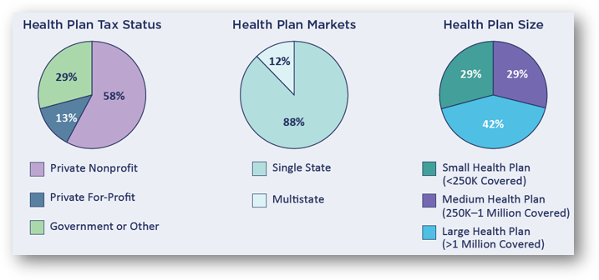
Annual Survey Findings
A Comprehensive Look
Survey covers 31 of the 42 states that have Medicaid Managed Care

Slide 13
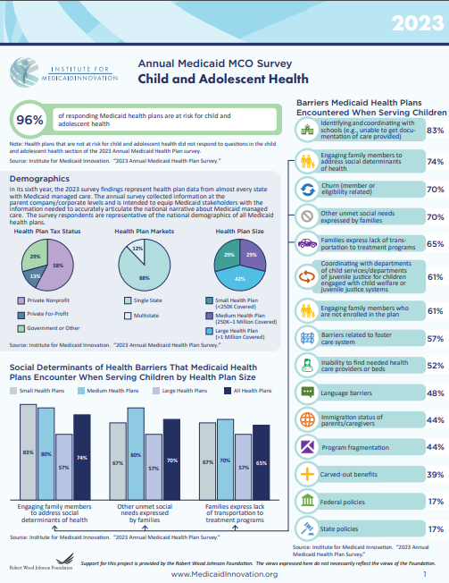
A Comprehensive Look
Annual Survey Findings
Value-Based Purchasing & Alternative Payment Models
High-Risk Care Coordination
Maternal and Perinatal Health
Pharmacy
Sexual and Reproductive Health
Child and Adolescent Health
Behavioral Health
Managed Long-Term Services and Supports
Social Determinants of Health
Telehealth
Health Equity and Structural Racism

Slide 14
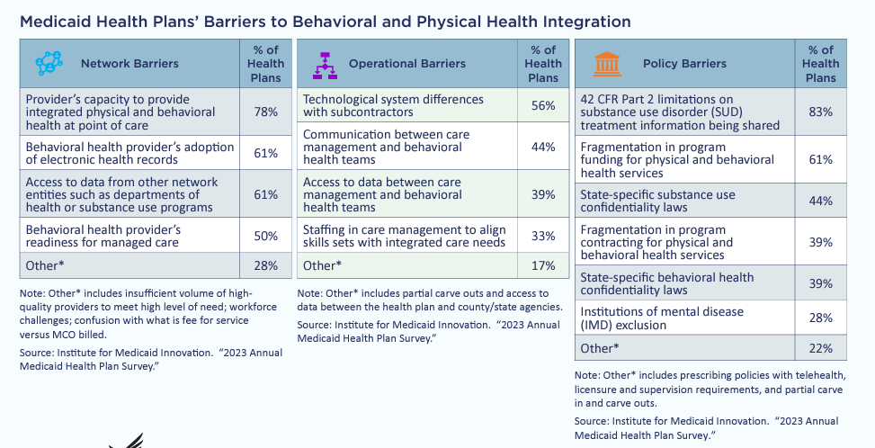
Integrating Behavioral and Physical Health
Annual Survey Findings
Source: Institute for Medicaid Innovation. “2023 Annual Medicaid Health Plan Survey.”

Slide 15
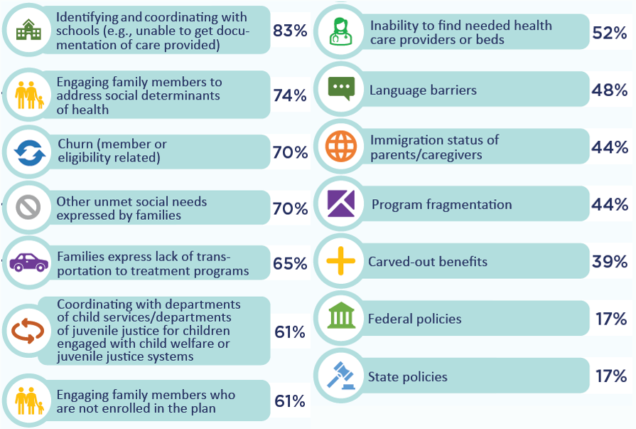
Barriers to Addressing Child and Adolescent Behavioral Health
Annual Survey Findings
Small
Health Plans
Medium
Health Plans
Large
Health Plans
All
Health Plans
Source: Institute for Medicaid Innovation. “2023 Annual Medicaid Health Plan Survey.”

Slide 16
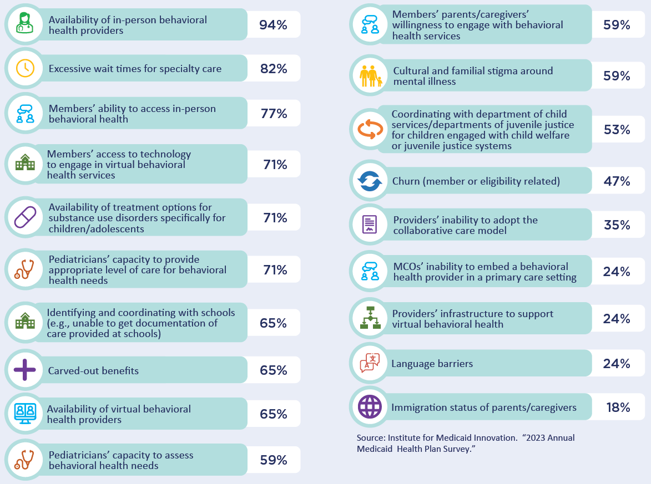
Annual Survey Findings
Barriers to Addressing Child Behavioral Health
Provider supply among top concerns
Source: Institute for Medicaid Innovation. “2023 Annual Medicaid Health Plan Survey.”

Slide 17
Annual Survey Findings
Coverage Doesn’t Equal Access
Despite having insurance coverage, people with Medicaid face serious challenges accessing needed healthcare and services
There are a wide range of factors that limit or impact Medicaid members’ access to care.
Members’ needs not being met
Members lack social supports
Workforce challenges
71%
92%
85%
Yes
Yes
Yes
No
No
No
Source: Institute for Medicaid Innovation. “2023 Annual Medicaid Health Plan Survey.”

Slide 18
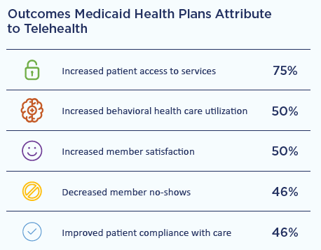
Telehealth: Addressing Access Issues
Annual Survey Findings
Medicaid health plans offer solutions to better meet members’ needs
Health plans taking action:
Plans connecting members to CBOs to address telehealth issues
School-based behavioral health services
Evidence-based remote patient monitoring
46%
58%
54%
Yes
No
Yes
No
Source: Institute for Medicaid Innovation. “2023 Annual Medicaid Health Plan Survey.”

Slide 19
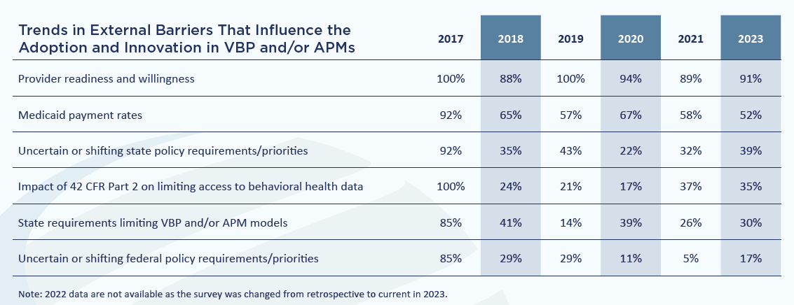
Annual Survey Findings
The Future of Medicaid: Value-Based Care
Rates of barriers experienced are decreasing but persist
Source: Institute for Medicaid Innovation. “2023 Annual Medicaid Health Plan Survey.”

Slide 20
Annual Survey Findings
Health Equity and Identifying Bias
Percentage of Medicaid Health Plans That Evaluated Bias in Clinical Algorithms, Policies, or Risk Prediction Models in the Last 12 Months
Did not evaluate
Did evaluate
34%
Did evaluate AND changed or abandoned algorithms, policies, or models if bias was discovered
58%
8%
Source: Institute for Medicaid Innovation. “2023 Annual Medicaid Health Plan Survey.”

Slide 21
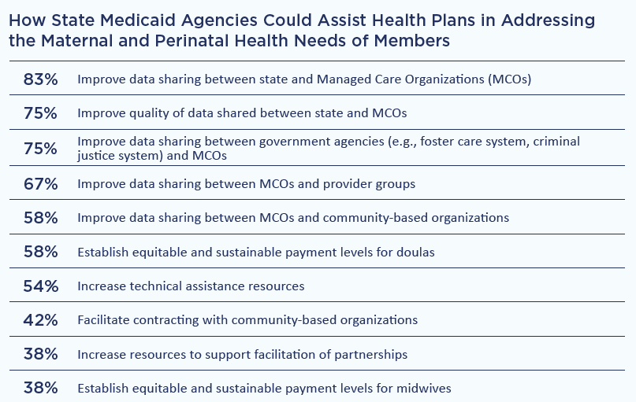
Annual Survey Findings
Data Sharing is an Opportunity for Improvement
Source: Institute for Medicaid Innovation. “2023 Annual Medicaid Health Plan Survey.”

Slide 22
Redetermination Survey Findings

Slide 23
New National Redetermination Survey
Redetermination Survey Findings
Survey 1
Survey 2
Survey 3
Survey 4
Fielded
Results
Fielded
Results
Fielded
Results
Fielded
Results
May
June
July
Aug.
Sep.
Oct.
Nov.
Dec.
Jan.
Feb.
Mar.
Apr.
2023
2024

Slide 24
A Broad Range of MCOs Represented
Redetermination Survey Findings
Source: Institute for Medicaid Innovation. “2023–2024 Redetermination Survey Findings 4 of 4.”

Slide 25
Medicaid MCO Representation Across the Board
Redetermination Survey Findings
Source: Institute for Medicaid Innovation. “2023–2024 Redetermination Survey Trends.”

Slide 26
Disenrollment: Losses Weren’t as Deep as Some Expected
Redetermination Survey Findings
Some Medicaid Health Plans did not lose as many enrollees as they expected to lose at the start of redetermination.
Source: Institute for Medicaid Innovation. “2023–2024 Redetermination Survey Trends.”

Slide 27
How Redetermination Impacted Capitation, Risk Mitigation, Actuarial Soundness
Redetermination Survey Findings
Source: Institute for Medicaid Innovation. “2023–2024 Redetermination Survey Trends.”

Slide 28
Community Outreach Strategies Among Medicaid MCOs
Redetermination Survey Findings
Top-5 Most Used Strategies:
Collaborated with community health centers on patient outreach
Partnered with community-based organizations in support of educating individuals and communities
Hosted in-community events
Had health plan reps in community hubs
Partnered with schools to inform parents of redetermination process
Source: Institute for Medicaid Innovation. “2023–2024 Redetermination Survey Trends.”

Slide 29
Data Continued as an Opportunity for Improvement
Redetermination Survey Findings
Source: Institute for Medicaid Innovation. “2023–2024 Redetermination Survey Trends.”

Slide 30
Perinatal Health Priorities

Slide 31
Percentage of Births Covered by Medicaid Nationally
Perinatal Health Priorities
41%
of all births in the United States are covered by Medicaid
Medicaid finances more than half of births:
In rural areas, and
Among individuals under age 19, and
Black, Indigenous and People of Color individuals.
Prevailing health inequity: Individuals enrolled in Medicaid face barriers accessing high-quality care early in pregnancy and in the postpartum period because of a variety of factors, including eligibility and coverage gaps, unmet social needs, and issues related to implicit bias and racism.
Osterman, M. J. K., Hamilton, B. E., Martin, J. A., Driscoll, A. K., & Valenzuela, C. P. (2024, April 4). Births: Final Data for 2022. National Vital Statistics Reports. https://www.cdc.gov/nchs//data/nvsr/nvsr73/nvsr73-02.pdf
MACPAC. (2020). Medicaid’s Role in Financing Maternity Care. https://doi.org/10.26099/2w1h-h609. https://www.macpac.gov/wp-content/uploads/2020/01/Medicaid’s-Role-in-Financing-Maternity-Care.pdf

Slide 32
Percentage of Births Covered by Medicaid Vary
Perinatal Health Priorities
As high as:
61% in Louisiana
57% in Mississippi
55% in New Mexico
51% in Oklahoma
48% in Texas
As low as:
30% in Wyoming
27% in South Dakota
22% in North Dakota
22% in New Hampshire
17% in Utah
17%–30%
48%–61%
KFF. (2022). State Facts, Births Financed by Medicaid. https:://www.kff.org/medicaid/state-indicator/births-financed-by-medicaid/?activeTab=map&currentTimeframe=0&selectedDistributions=percent-of-births-financed-by-medicaid&sortModel=%7B%22colId%22:%22Location%22,%22sort%22:%22asc%22%7D

Slide 33
Addressing the Maternal Health Crisis
Perinatal Health Priorities
Medicaid health plans expanding coverage of maternal health services
Year-to-Year Comparison for Medicaid Health Plans’ Covered Benefits for Pregnant Individuals
Institute for Medicaid Innovation. “2023 Annual Medicaid Health Plan Survey.” https://medicaidinnovation.org/wp-content/uploads/2023/11/Perinatal_MCO_Survey_Fact-Sheet_2023-Final-111423.pdf

Slide 34
Medicaid Coverage of Key Perinatal Health Services
Perinatal Health Priorities
Postpartum Depression
Medicaid covers services related to pregnancy, including behavioral health services for mental health and substance use disorders.
States have increased access to prenatal and postpartum screening for risk factors and include access to treatment and support services for individuals at high risk of postpartum depression.
24 states require standardized screening tools. In Kansas, Medicaid supports screenings during the 12-months postpartum period under the child's Medicaid benefit.
State recommends caregiver/maternal depression screening as part of a well-child visit
State requires caregiver/maternal depression screening as part of a well-child visit
State allows caregiver/maternal depression screening as part of a well-child visit
Unknown
Johnson, R., Eldridge, G. N., Khanal, P., & Zephyrin, L. C. (2023, November). State policies to improve perinatal health outcomes. Commonwealth Fund. https://doi.org/10.26099/x0x0-gt30

Slide 35
Medicaid Coverage of Key Perinatal Health Services
Perinatal Health Priorities
Midwives
Midwifery services include a full range of primary health care services for individuals from adolescence beyond menopause, including primary care, gynecologic and family planning services, preconception care, and care during pregnancy, childbirth, and the postpartum period.
Midwives also provide well-women care across the lifespan.
26 states and D.C. reimburse midwives at 100% of the physician rate, while 5 states reimburse at 75%.
State only covers certified nurse-midwives
State covers services from other midwives in addition to certified nurse-midwives
Johnson, R., Eldridge, G. N., Khanal, P., & Zephyrin, L. C. (2023, November). State policies to improve perinatal health outcomes. Commonwealth Fund. https://doi.org/10.26099/x0x0-gt30

Slide 36
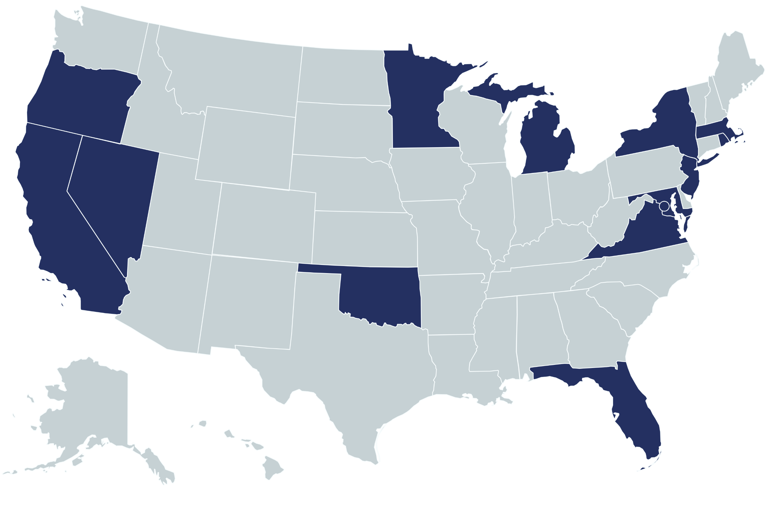
Medicaid Coverage of Key Perinatal Health Services
Perinatal Health Priorities
Doulas
13 states and D.C. have Medicaid coverage for doula services.
Doulas provide non-clinical emotional, physical, and educational support to a mother before, during, and after childbirth.
Doulas use techniques that require minimal interventions and have high rates of patient satisfaction.
Rhode Island was the first state to require coverage of doula services on July 1, 2022.
State does not cover doula services
State covers and actively reimburses doula services
Johnson, R., Eldridge, G. N., Khanal, P., & Zephyrin, L. C. (2023, November). State policies to improve perinatal health outcomes. Commonwealth Fund. https://doi.org/10.26099/x0x0-gt30

Slide 37
Medicaid Coverage of Key Perinatal Health Services
Perinatal Health Priorities
Perinatal Community Health Workers
Perinatal community health workers (CHWs) prepare individuals to serve within their community in various capacities, including direct perinatal care and support, advocacy and policy engagement, and entry-level social work and public health careers.
Since 2012, Oregon Medicaid has covered traditional health workers (THWs), an umbrella term for five specialty types of frontline public health workers who work in a community or clinic under the direction of a licensed health provider.
State does not cover community health workers
State’s community health worker coverage does not include perinatal services
State’s community health worker coverage includes perinatal services
State’s community health worker coverage does not specify inclusion of perinatal services
Johnson, R., Eldridge, G. N., Khanal, P., & Zephyrin, L. C. (2023, November). State policies to improve perinatal health outcomes. Commonwealth Fund. https://doi.org/10.26099/x0x0-gt30
Mamatoto Village, Perinatal Community Health Worker, https://www.mamatotovillage.org/perinatal-community-health-worker/

Slide 38
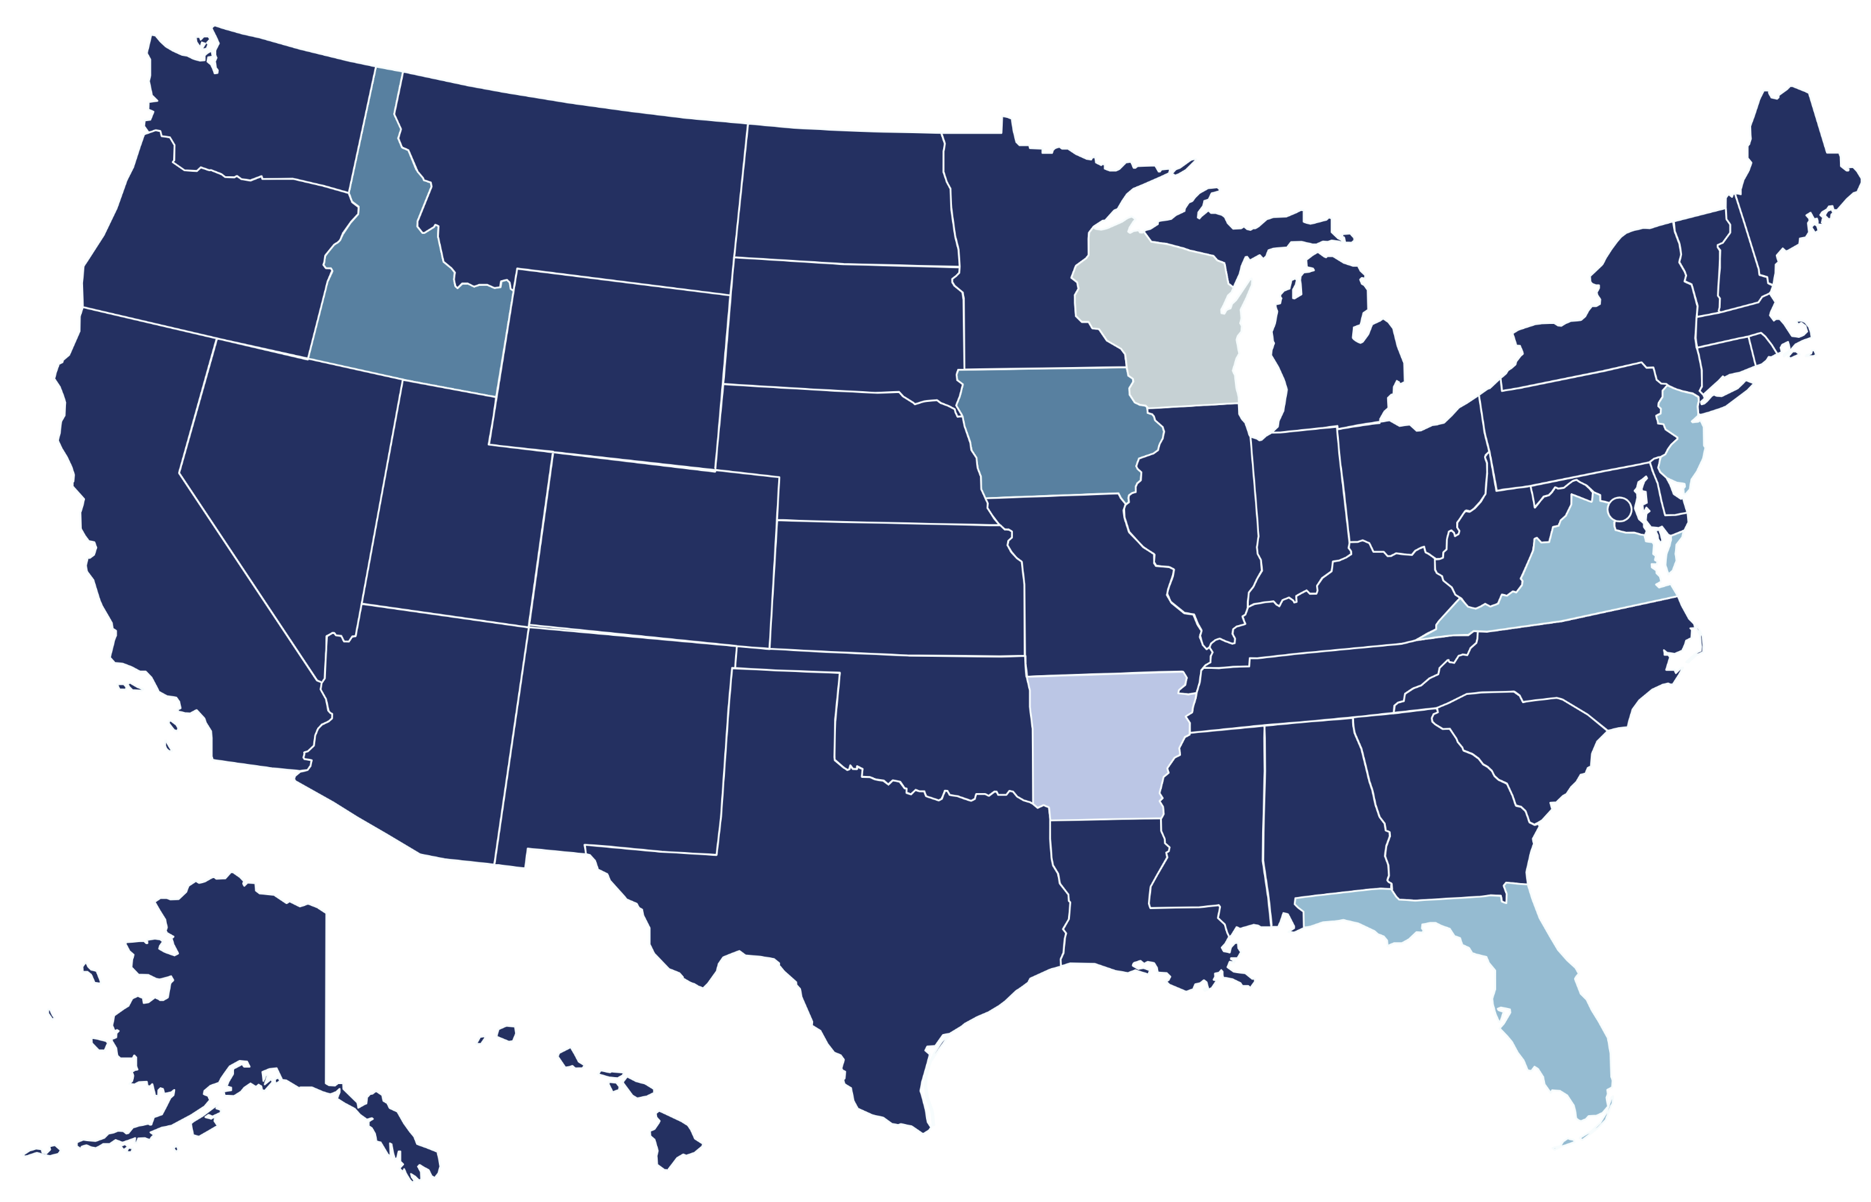
Medicaid Coverage of Key Perinatal Health Services
Perinatal Health Priorities
Postpartum Coverage Extension
Most states have taken up the option to extend Medicaid eligibility until one year after delivery or when the pregnancy ends.
Medicaid must cover pregnant individuals with incomes at or below 138% of the federal poverty level through 60 days post-partum.
Wisconsin has a pending 1115 waiver to extend postpartum coverage from 2 to 3 months. Arkansas’ governor does not support expanding postpartum coverage.
State Plan Amendment Approved
Legislation Proposed
Section 1115 Waiver Approved
Pending Section 1115 Waiver for Limited Extension
Legislation Did Not Advance
Johnson, R., Eldridge, G. N., Khanal, P., & Zephyrin, L. C. (2023, November). State policies to improve perinatal health outcomes. Commonwealth Fund. https://doi.org/10.26099/x0x0-gt30

Slide 39
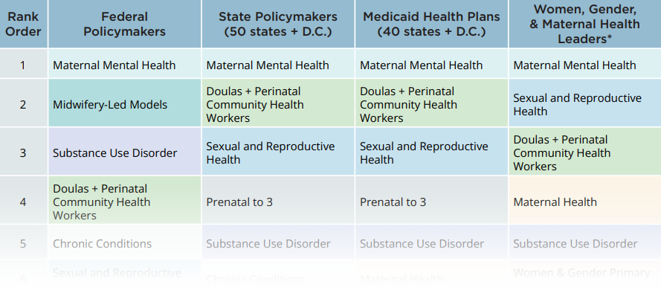
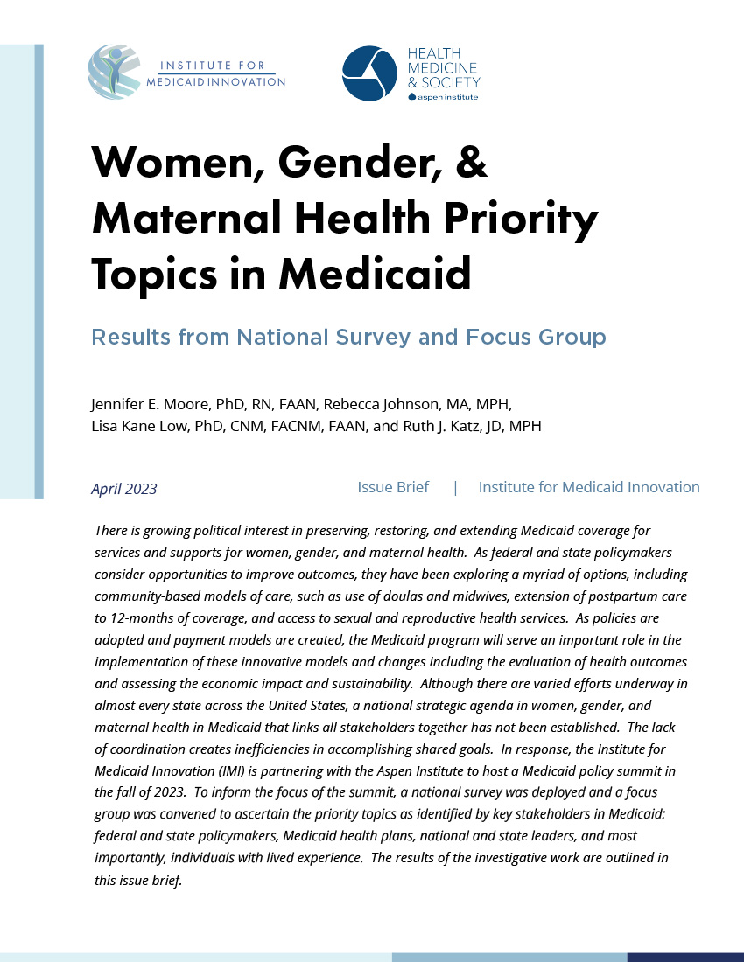
2023 Priority Topics (Ranked) in Women, Gender, & Maternal Health by Medicaid Stakeholder Group
Perinatal Health Priorities
Institute for Medicaid Innovation. (2023). Women, Gender, and Maternal Health Priority Topics in Medicaid: Results from National Survey and Focus Groups. Washington, D.C. https://medicaidinnovation.org/wp-content/uploads/2023/04/IMI-Issue-Brief_WGH-Survey_FINAL.pdf
*Refers to individuals and organizations with expertise in women, gender, and maternal health as it relates to Medicaid policy. They represent many sectors including research, clinical practice, trade associations, advocacy, and community-based organizations.
39

Slide 40
Alternative Payment Models

Slide 41
Health Care Payment Learning and Action Network (HCP LAN) Theory of Change
Alternative Payment Models
Source: https://hcp-lan.org/apms-theory-of-change/

Slide 42
Husky Maternity Bundle Payment Program
Alternative Payment Models
Connecticut Department of Social Services (DSS)
Source: Connecticut Department of Social Services

Slide 43
Husky Maternity Bundle Payment Program
Alternative Payment Models
Connecticut Department of Social Services (DSS)
Source: Connecticut Department of Social Services

Slide 44
The Future of Medicaid: Value-Based Care
Alternative Payment Models
Rates of barriers experienced are decreasing but persist
Source: Institute for Medicaid Innovation. “2023 Annual Medicaid Health Plan Survey.”

Slide 45
Learn More!

Slide 46
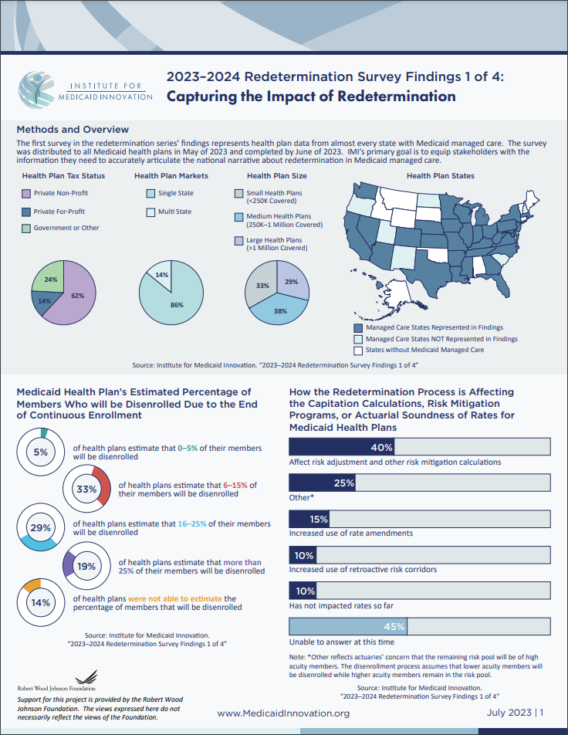
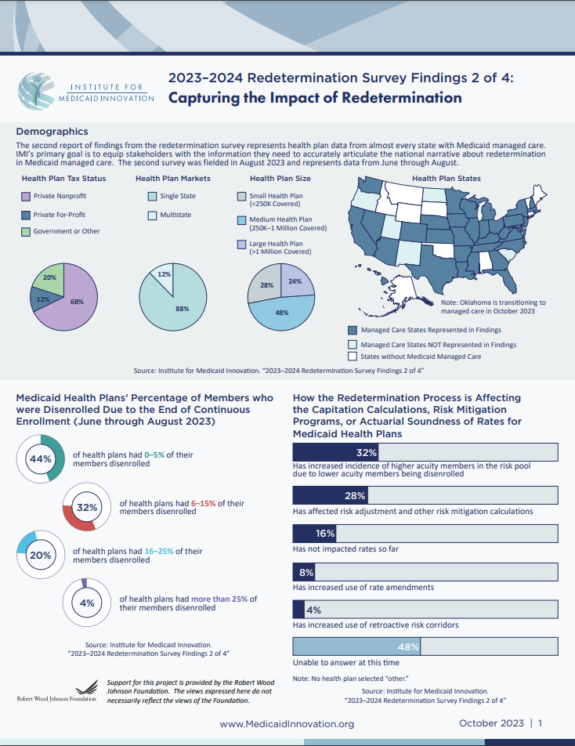
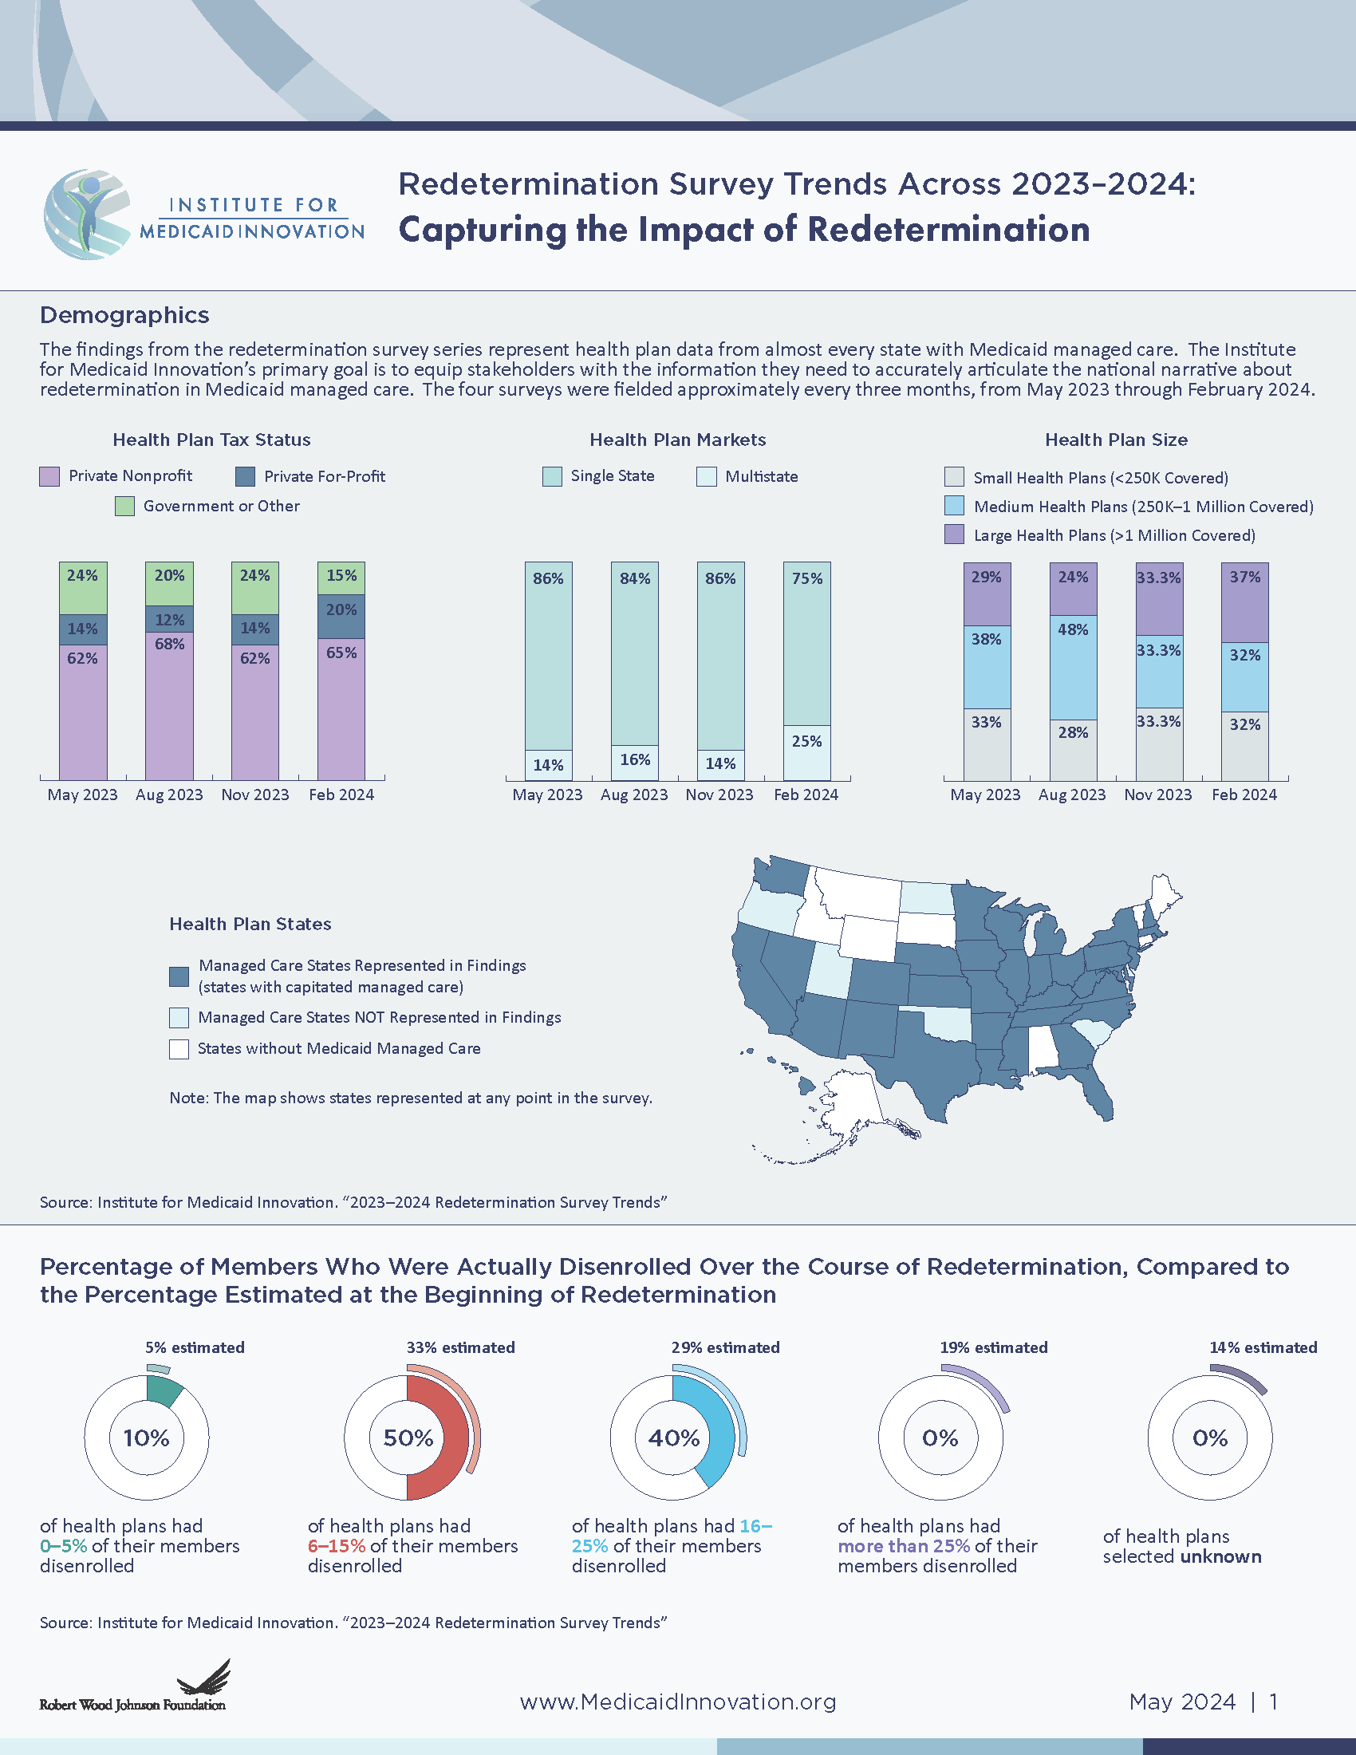
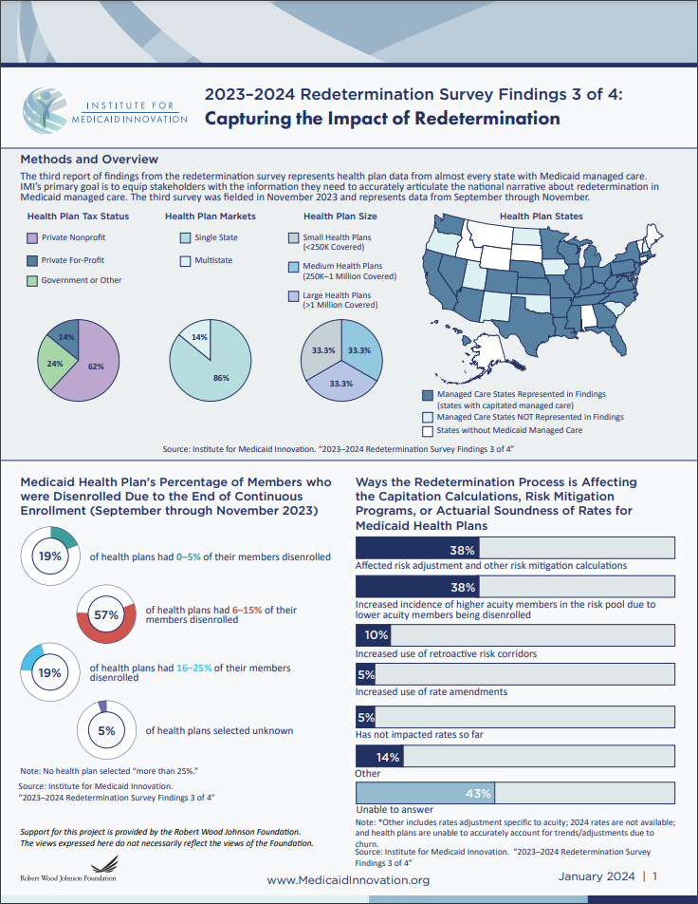
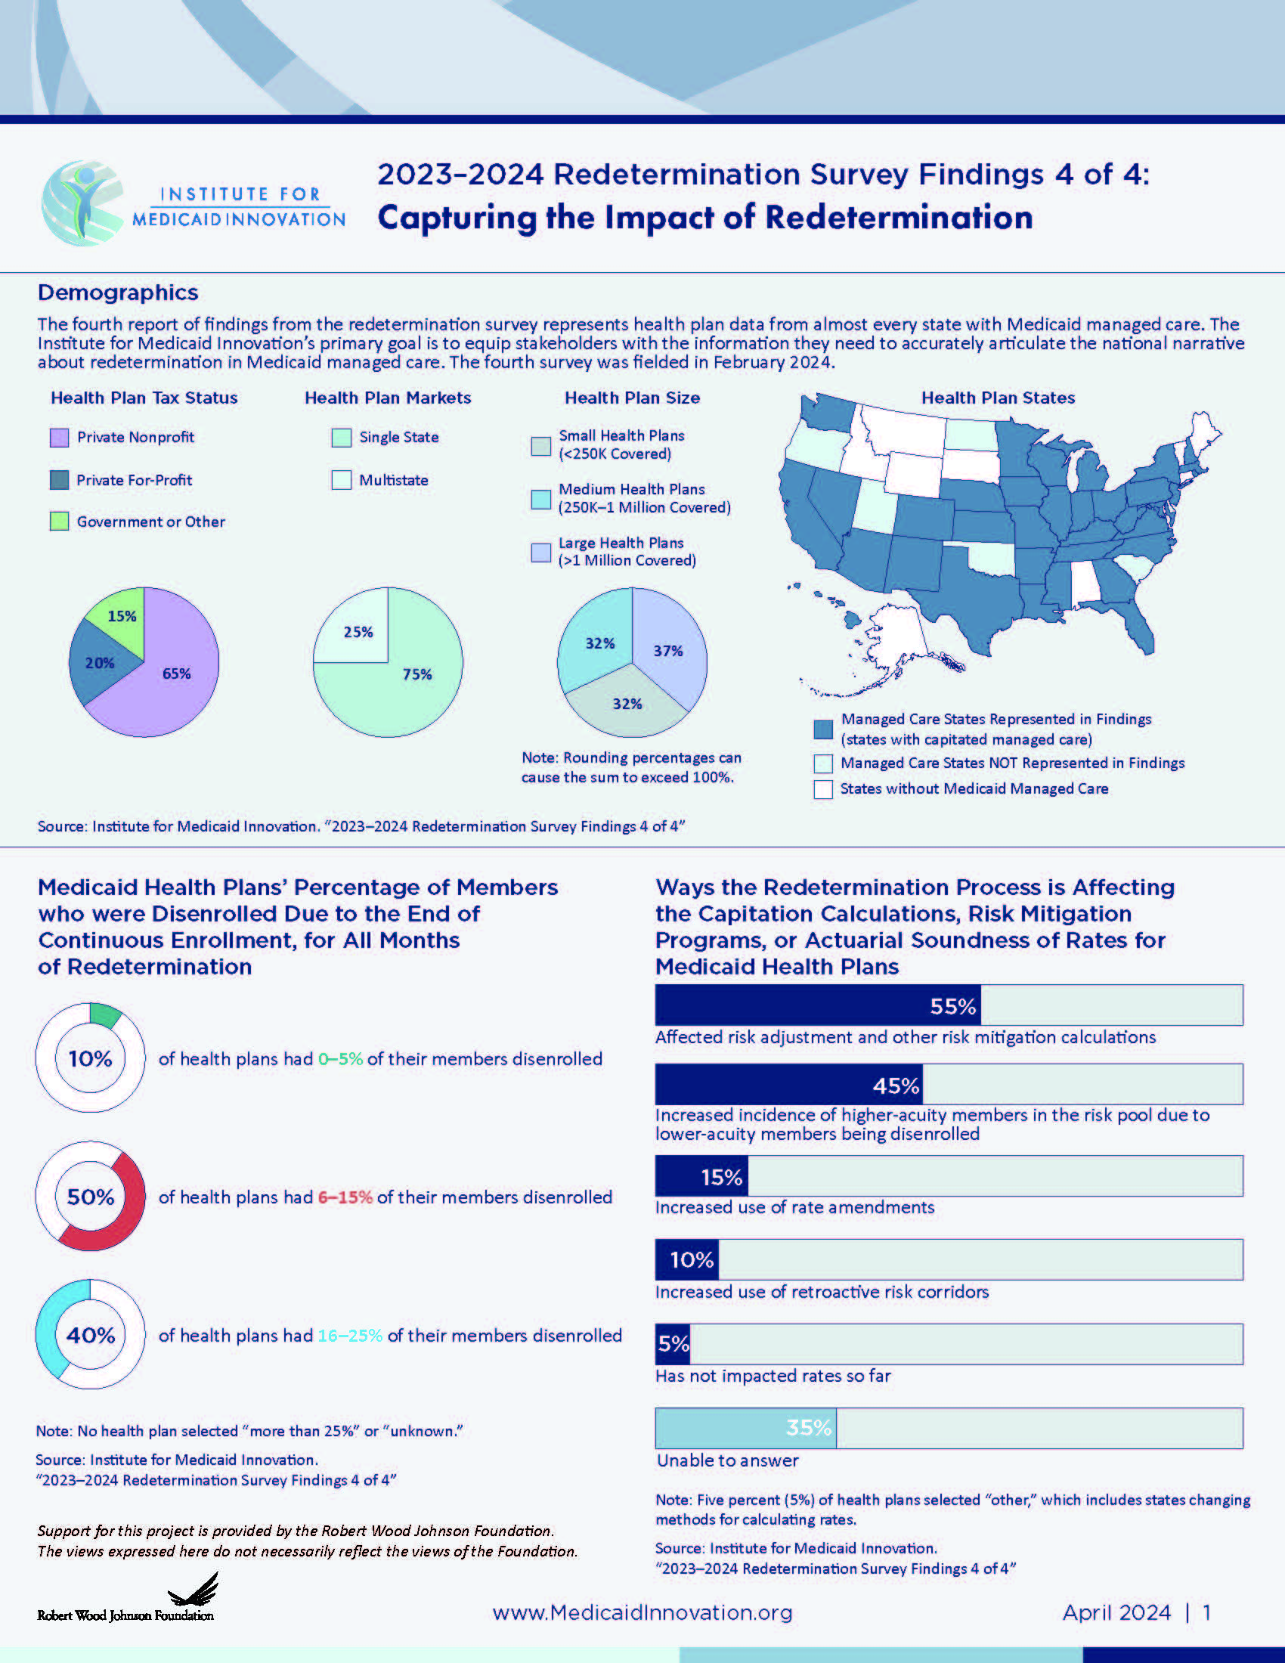
Four Snapshots + Trends
Redetermination Survey Findings

Slide 47
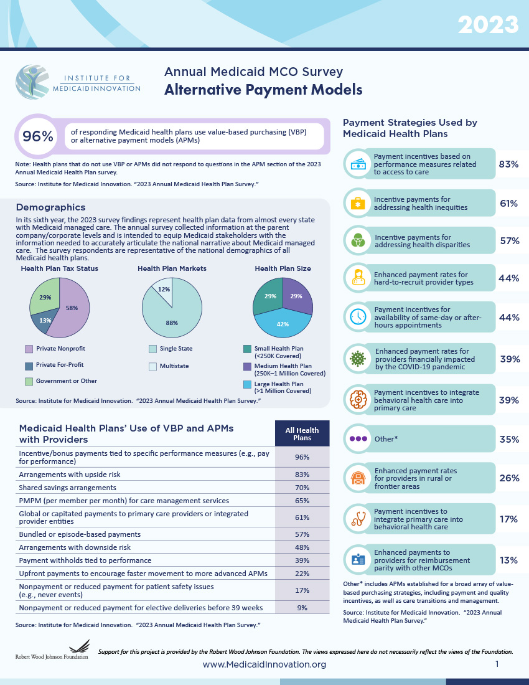
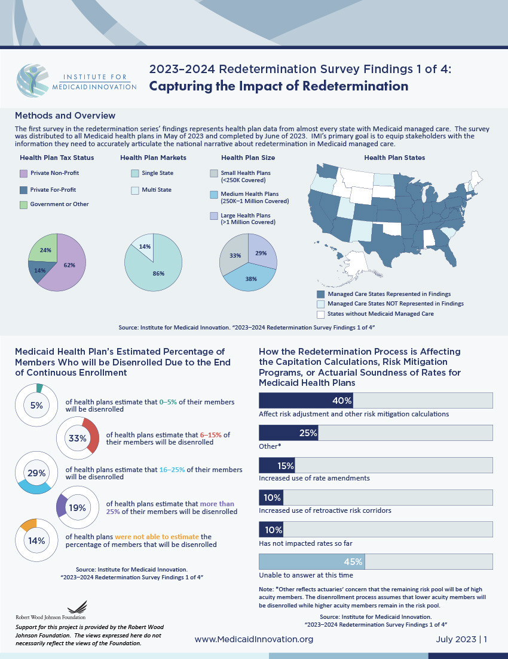
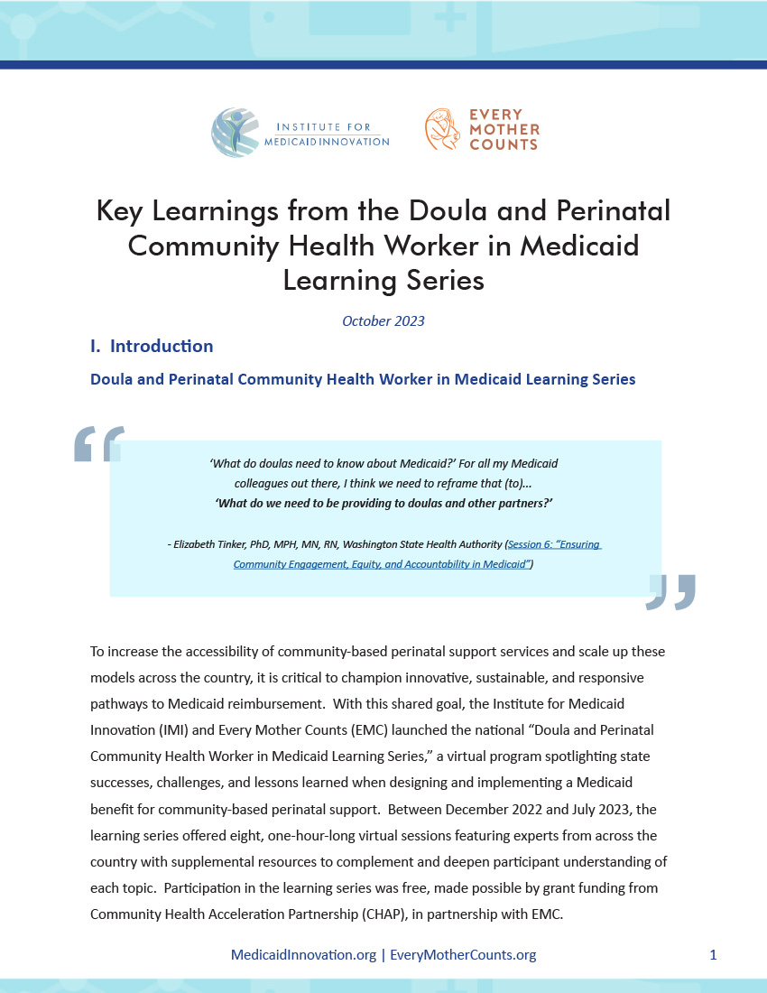
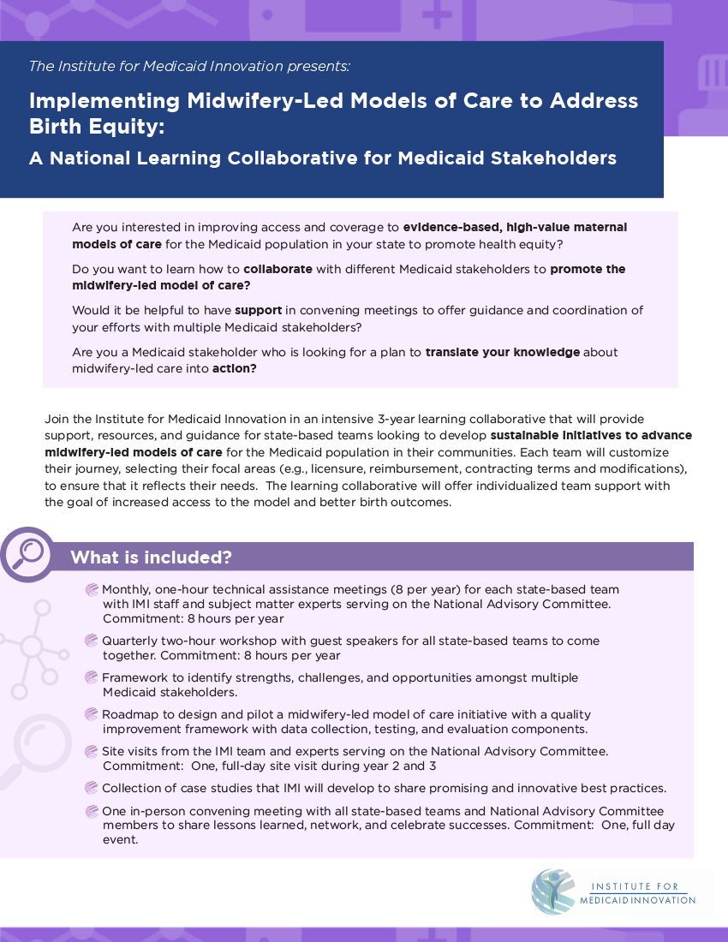
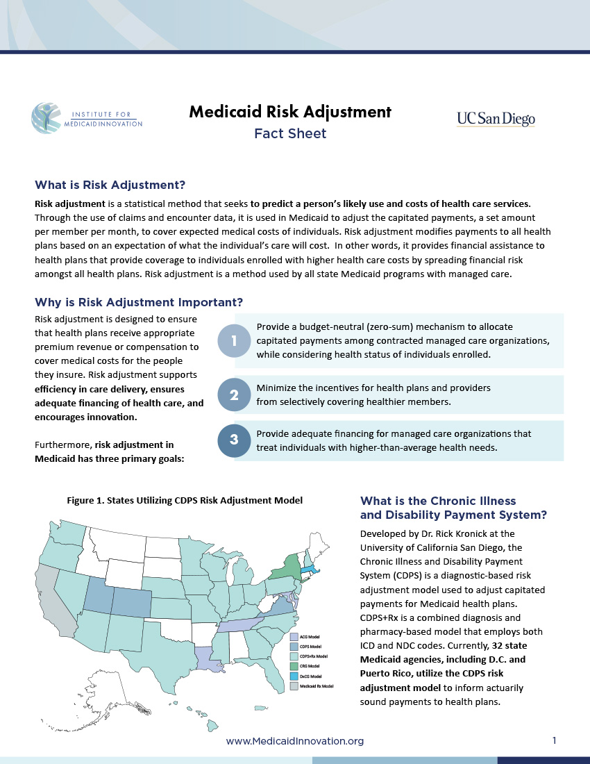
A Broad Portfolio of Meaningful Work Impacting Medicaid
Medicaid Innovation
Annual MCO Survey
MCO Redetermination Survey
Community Partnerships in Medicaid Toolkit
National Maternal Health Strategy and Blueprint
Doula and Perinatal Community Health Worker Learning Series
Midwifery in Medicaid Business Case Learning Series
Medicaid Risk Management (CDPS)

Slide 48
Learn more about IMI
Contact Dr. Jennifer Moore
Email me at Jmoore@MedicaidInnovation.org
Download resources at www.MedicaidInnovation.org
Follow us on social media
Follow us on Twitter at @Innov8Medicaid and on Facebook and LinkedIn
Subscribe to our newsletter
Subscribe on our website at www.MedicaidInnovation.org/news/newsletters
48

Slide 49
Thank You!
49

